Slide 1
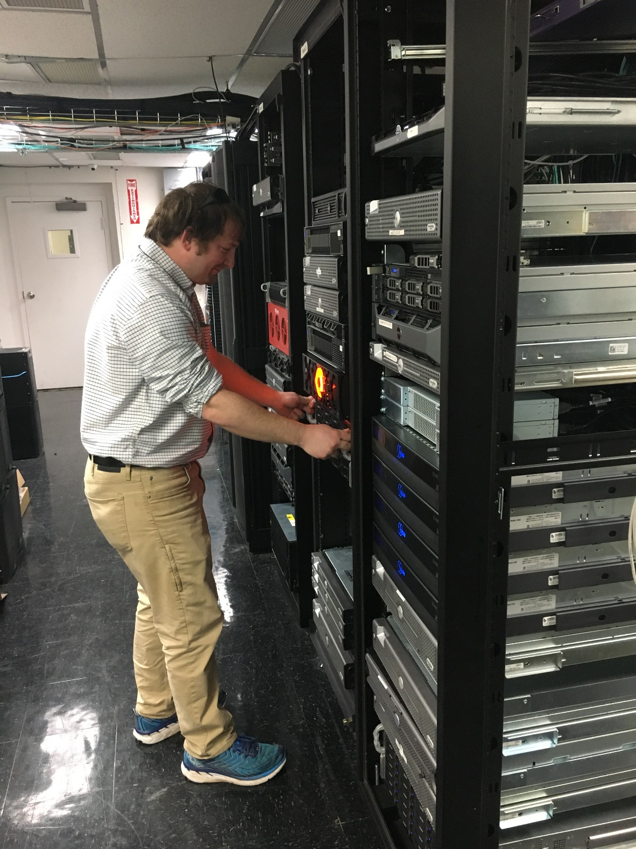
New Retail Website

Slide 2

New Retail website
Design
  CCS hired a consultant who is known in the industry as one of the best web designers. Contracts with Dell to do their websites.
  Looked at 21 similar websites
    Competitors
    Indirect competitors (Walgreens, Shutterfly…)
  Reviewed existing customer wish list
  Reviewed existing marketing wish list
  Looked at existing weakness in the current website
  Looked at existing strengths in the current website
  Needed one website for both Mobile and Desktop

Slide 3
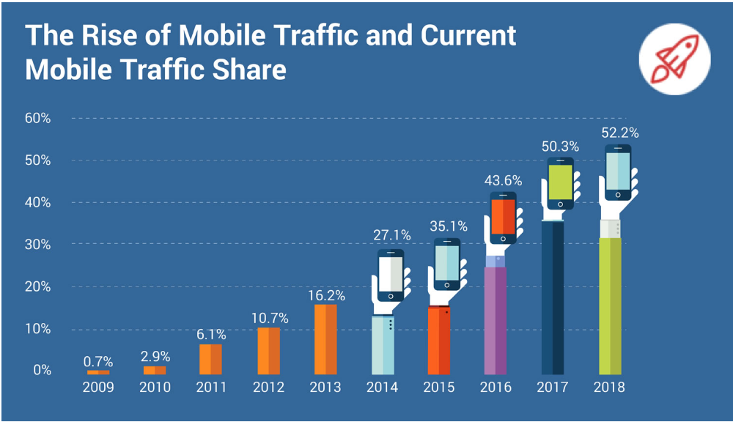
New Retail website
Mobile vs. Desktop
  71% off all CCS traffic is from a mobile device
    This number has been around 65-70% for the past few years
    Order averages are typically lower on mobile devices
    Customers are more prone to make a purchase quickly on their phone
    Orders placed on Mobile devices are shorter sessions than desktop
    The longer the visits the higher the conversion rates and more dollars in the cart

Slide 4
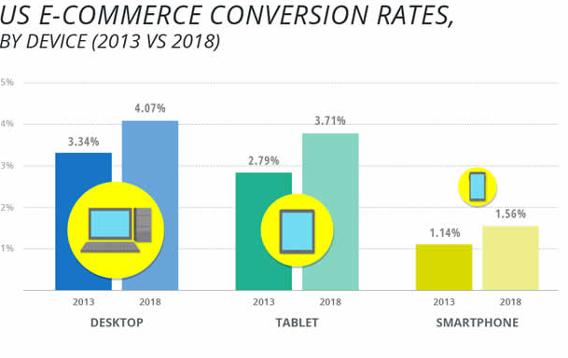
New Retail website
  Existing mobile website lacks some features of the existing desktop
  Ecommerce mobile website struggles with lower conversion rates
  All functions and features need to work on mobile website that work on desktop

Slide 5
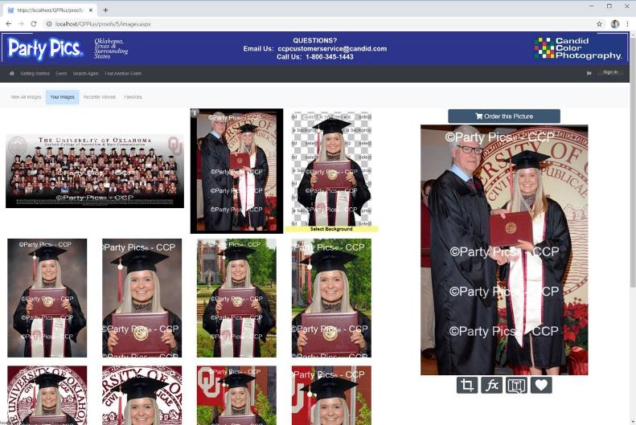
New Retail website – Images page - Desktop
  Continue to brand your page with your logo’s
  Larger Group/Horizonal images
  Uses 100% of monitor and will resize based on monitor size
  Clean fresh look
  Tools work both on desktop and mobile

Slide 6
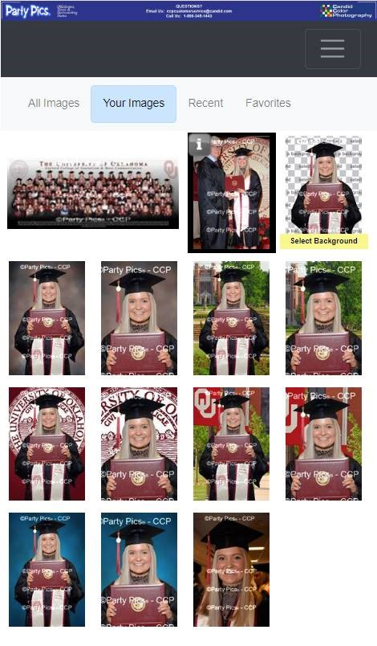
New Retail website Images page - Mobile
  Better branding with your logo’s
  Larger Group/Horizonal images
  Uses 100% of screen and will resize based on phone/tablet size
  Clean fresh look
  Tools work both on desktop and mobile
Personalization and Customization

Slide 7
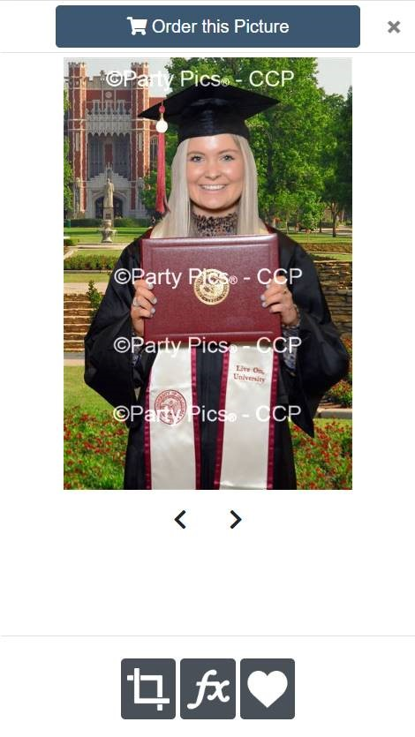
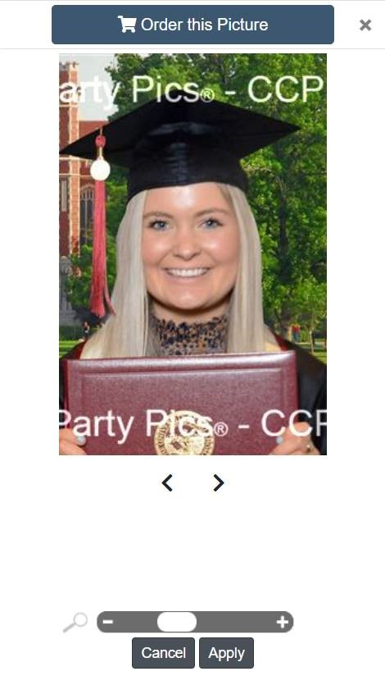
Mobile – Cropping and Personalization
  Cropping
  Background Selection
  Text and titles
  More rendering

Slide 8
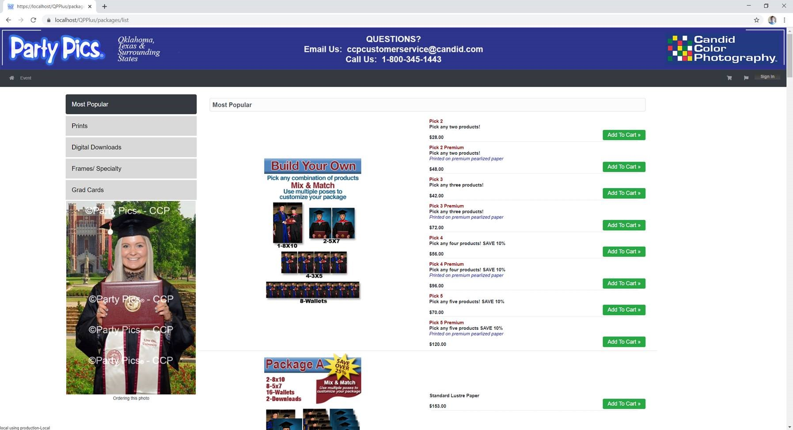
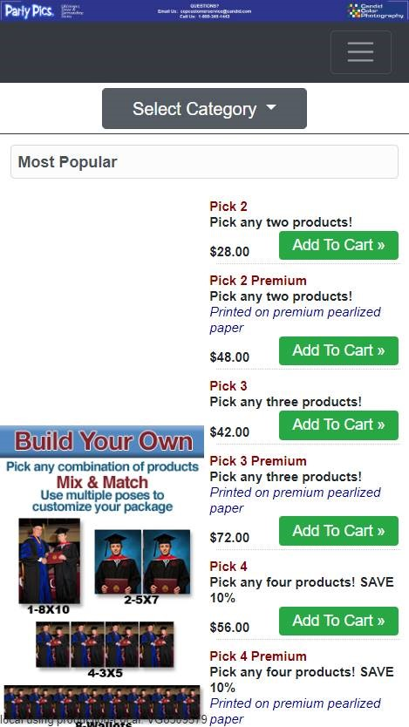
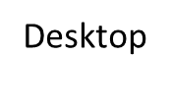
Products Page – Desktop - Mobile
Desktop
Mobile

Slide 9
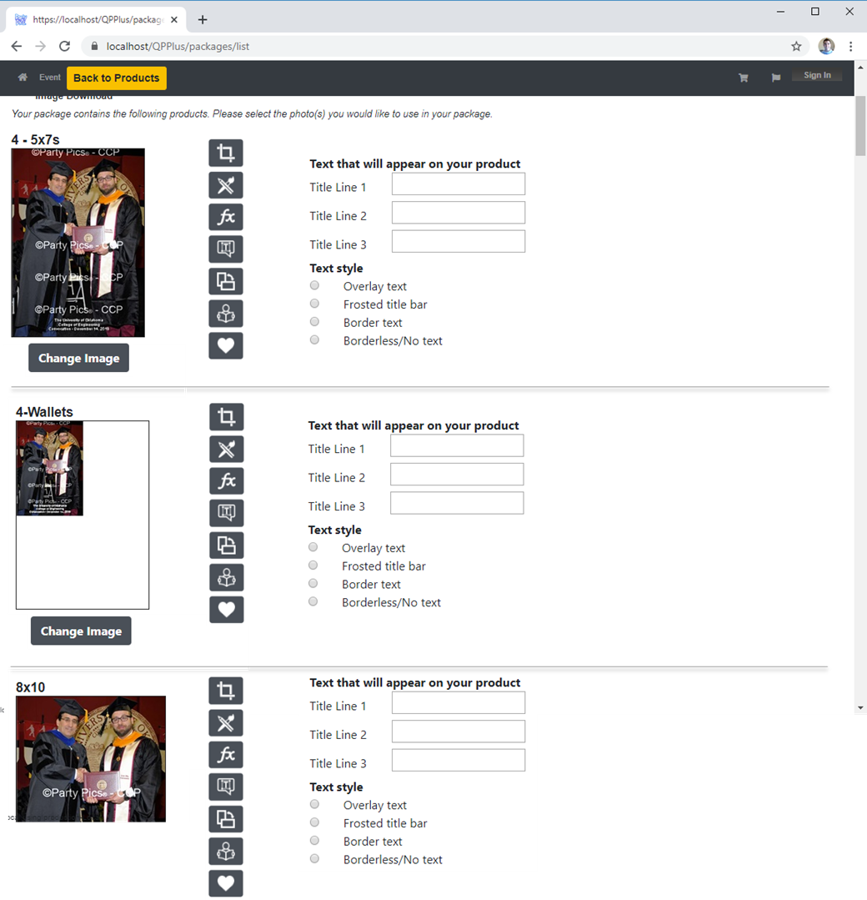
Package configuration – Desktop/Mobile
Existing packages work
Easily entry titles
Easily configure many products
Works well with Mix and match and multi product packages
Renders
Cleaner look

Slide 10
New retail website
Full beta in April

