Slide 1
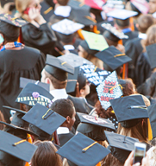

Graduation
Solutions
What’s in it for you?
And how can you help schools?
Update April 11, 2020

Slide 2


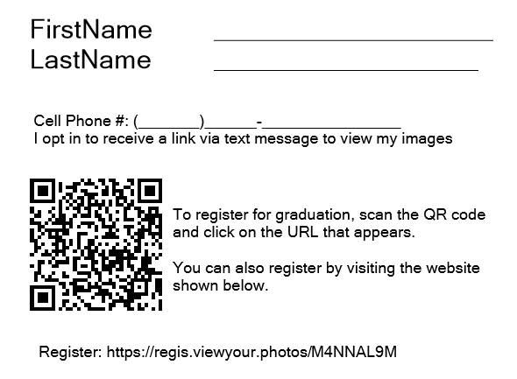
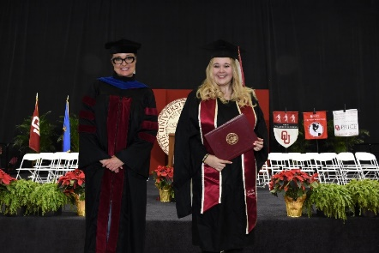
Solutions for Ceremonies
Touch-free QR code registration
New poses
Photo Match
Notes:
The school’s needs have changed
The graduate’s needs have changed
If you haven’t, contact your grad coordinators now
Do they have a plan?
Can you be part of the planning?
Convince them to delay the decision until they have to make it (still 6-12 weeks from graduations)
If they can’t hold “events” offer smaller or private “ceremonies” or “sessions”
Each college have their own ceremony

Slide 3
Arrange with the LOCAL school to do the drive thru ceremony and/or virtual ceremony
Schools where the graduates are still in the area
High schools
Local commuter colleges
Votechs

Slide 4
We do this because:
We want to keep others out of the school so we don’t lose next year’s graduation
Or we do it for a school we don’t have now so WE can do next year’s graduation
We want to make money creating the virtual ceremony
We want to sell pictures in some manner of grads

Slide 5
Steps
Students come to school to pick up THEIR diploma
They wear THEIR cap and gown
They drive up in parking lot and get THEIR diploma
Then walk over to OUR well spaced photo area
Perhaps, we have a tent
Use a background for TKO – have some good background choices
Have subjects register on their phone via QR code
We take 3 QUICK shots - with their diploma cover
They are sent “proofs” – could select image for virtual ceremony
They can buy things online from us = $$$
We also have identified image for the virtual ceremony

Slide 6
Other thoughts
We take the photos so we get CONSISTENT images for the ceremony
If they do not have caps and gowns, they come dressed nicely and get diploma picture
Might be done over more than one day
We might have multiple setups

Slide 7
Solutions for Ceremonies
Notes:
The school’s needs have changed
The graduate’s needs have changed
If you haven’t, contact your grad coordinators now
Do they have a plan?
Can you be part of the planning?
Convince them to delay the decision until they have to make it (still 6-12 weeks from graduations)
If they can’t hold “events” offer smaller or private “ceremonies” or “sessions”
Each college have their own ceremony

Slide 8
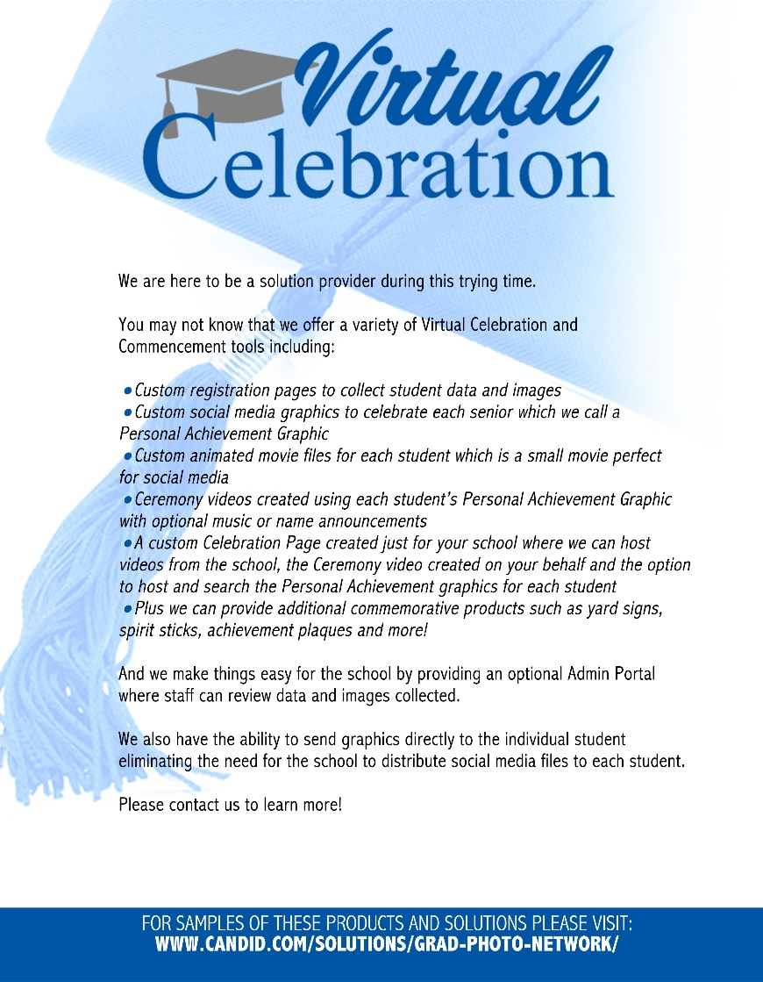
Intro letters

Slide 9

Options for schools and photographers

Slide 10


Ways to celebrate graduates
Personal Achievement Graphics (“PAGs”)
These graphics will honor the graduate by name and can include optional information such as degree, major, quote, graduate photo, school logo and school colors.
These graphics are a great way to create solidarity and spread cheer. They are intended to be shared via social media by the student or the school. PAGs can be distributed directly to students using a link to download their image or returned to the school in bulk.
Schools can use these graphics in other ceremony plans or they can be combined into a virtual ceremony video.

Slide 11
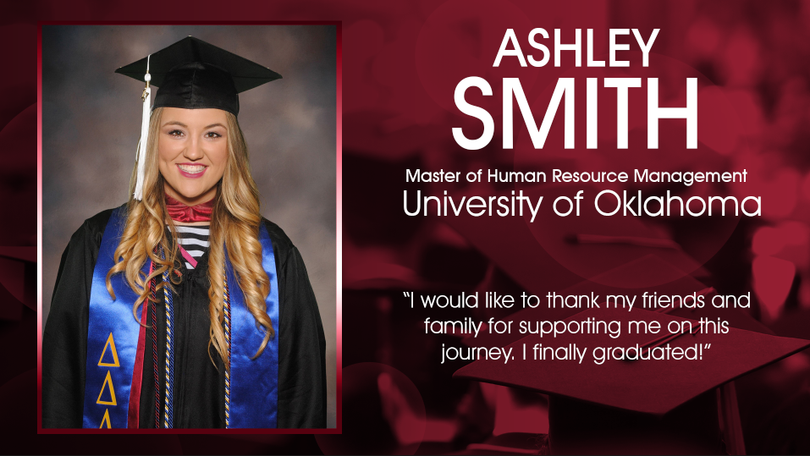

Ways to celebrate graduates
Personal Achievement Graphics (“PAGs”)
Options with and without an image.
Photographer created artwork available.
If added as a product on retail…. $.99.
Bulk order for an entire school, class, college will be $.59 each.
Pricing does not include image cutouts.
Delivery available to individuals like a typical download OR we will offer bulk delivery to the photographer for bulk orders.
Data to complete these can be collected with our NEW registration site.

Slide 12
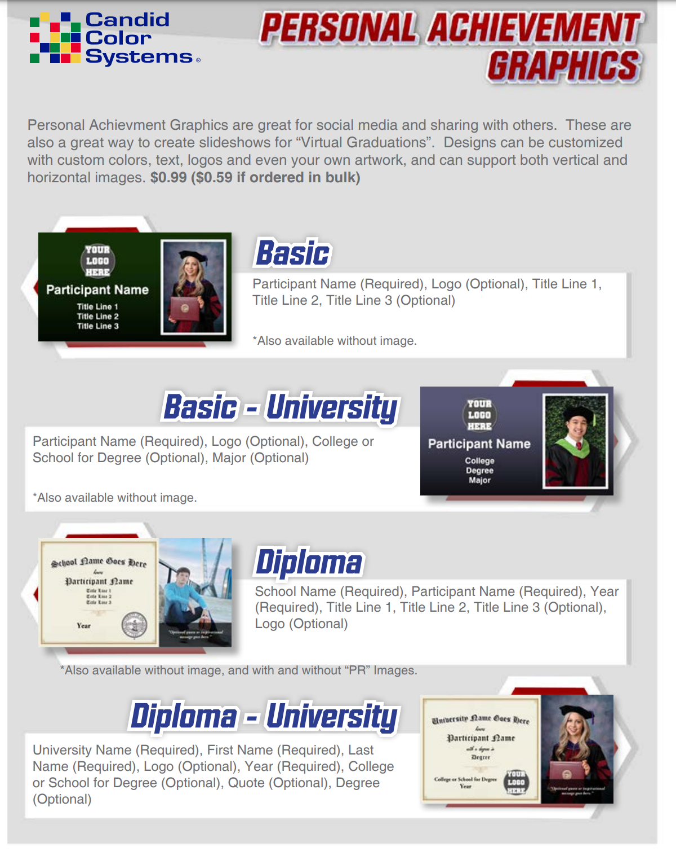
Ways to celebrate graduates
Personal Achievement Graphics (“PAGs”)
Style guide available.
A version to show schools with no pricing also available.

Slide 13

Ways to celebrate graduates- NEW
Name Announcement Clips (NAC) $1.18
– a super short movie file where we show the personal achievement graphic AND the student’s name is read aloud (not by a human) Geat for social media!
NOTE: When we make this product we ALSO make the PAG. So you do NOT need to Also buy the PAG. The student gets an NAC video and the PAG jpg.
Data to complete these can be collected with our NEW registration site.

Slide 14

Ways to celebrate graduates
Virtual Ceremony videos
We can offer a video combining all of the Personal Achievement Graphics for students in a particular college or program. This video would be delivered as a high-resolution mp4 and can be hosted on a website, delivered via social media or email link or even used during a live ceremony.
Virtual ceremony videos can be delivered with music or can be delivered with no music for the school to add their own audio. Name reading audio options are also available.
NEW option- With name announcements!

Slide 15
Ways to celebrate graduates
Virtual Ceremony videos
Style guide coming soon
Uses PAGs which are $.59 per graduate.
$50 per ceremony + $.15 per graduate
Example: a single 300 student ceremony would cost:
$50 + $.74 per student (x 300)= $272
Name announcement $.15/student addt’l
Data to complete these can be collected with our NEW registration site.

Slide 16
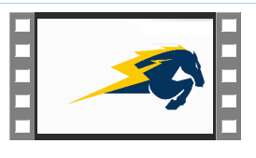
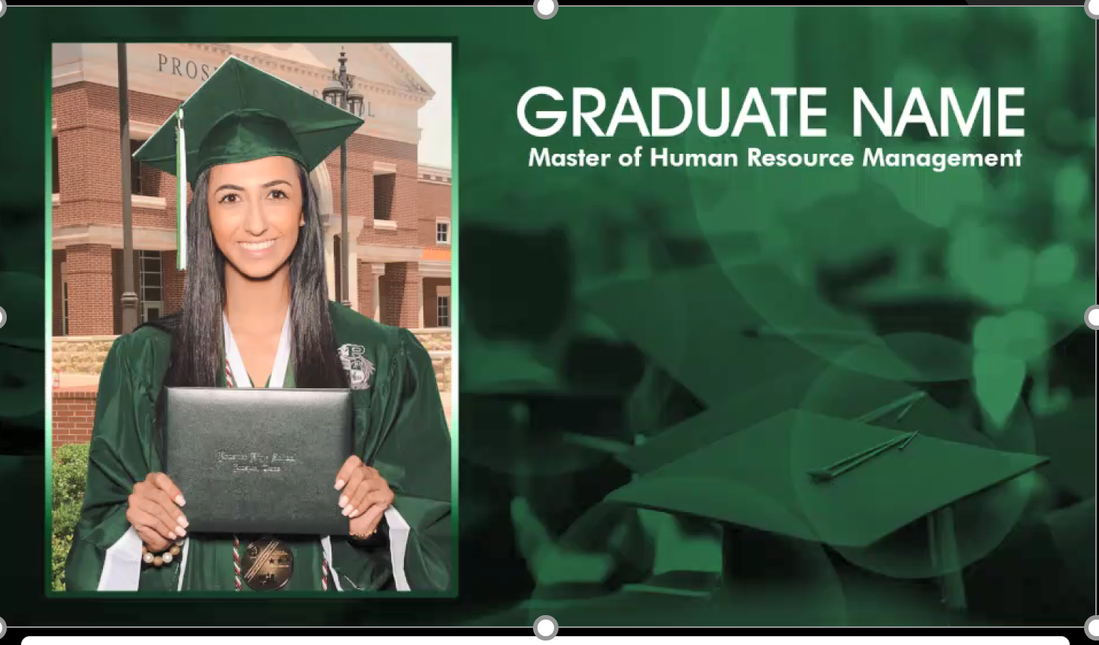
Ways to celebrate graduates
Graduate Animations
We offer animated, shareable graphics for individual students for when you want more visual appeal than a Personal Achievement Graphic.
Graduate Animations can also honor the student by name and can include optional information such as degree, major, quote, graduate photo, school logo and school colors.
The Animations are returned as mp4 files and are intended to be shared via social media by the student. They can be distributed directly to students using a link to download their animation or they can be returned to the school in bulk.

Slide 17
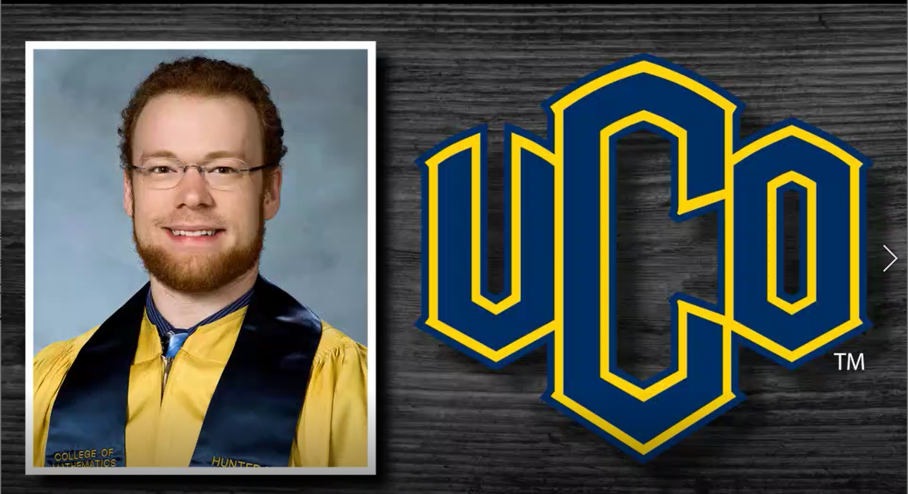
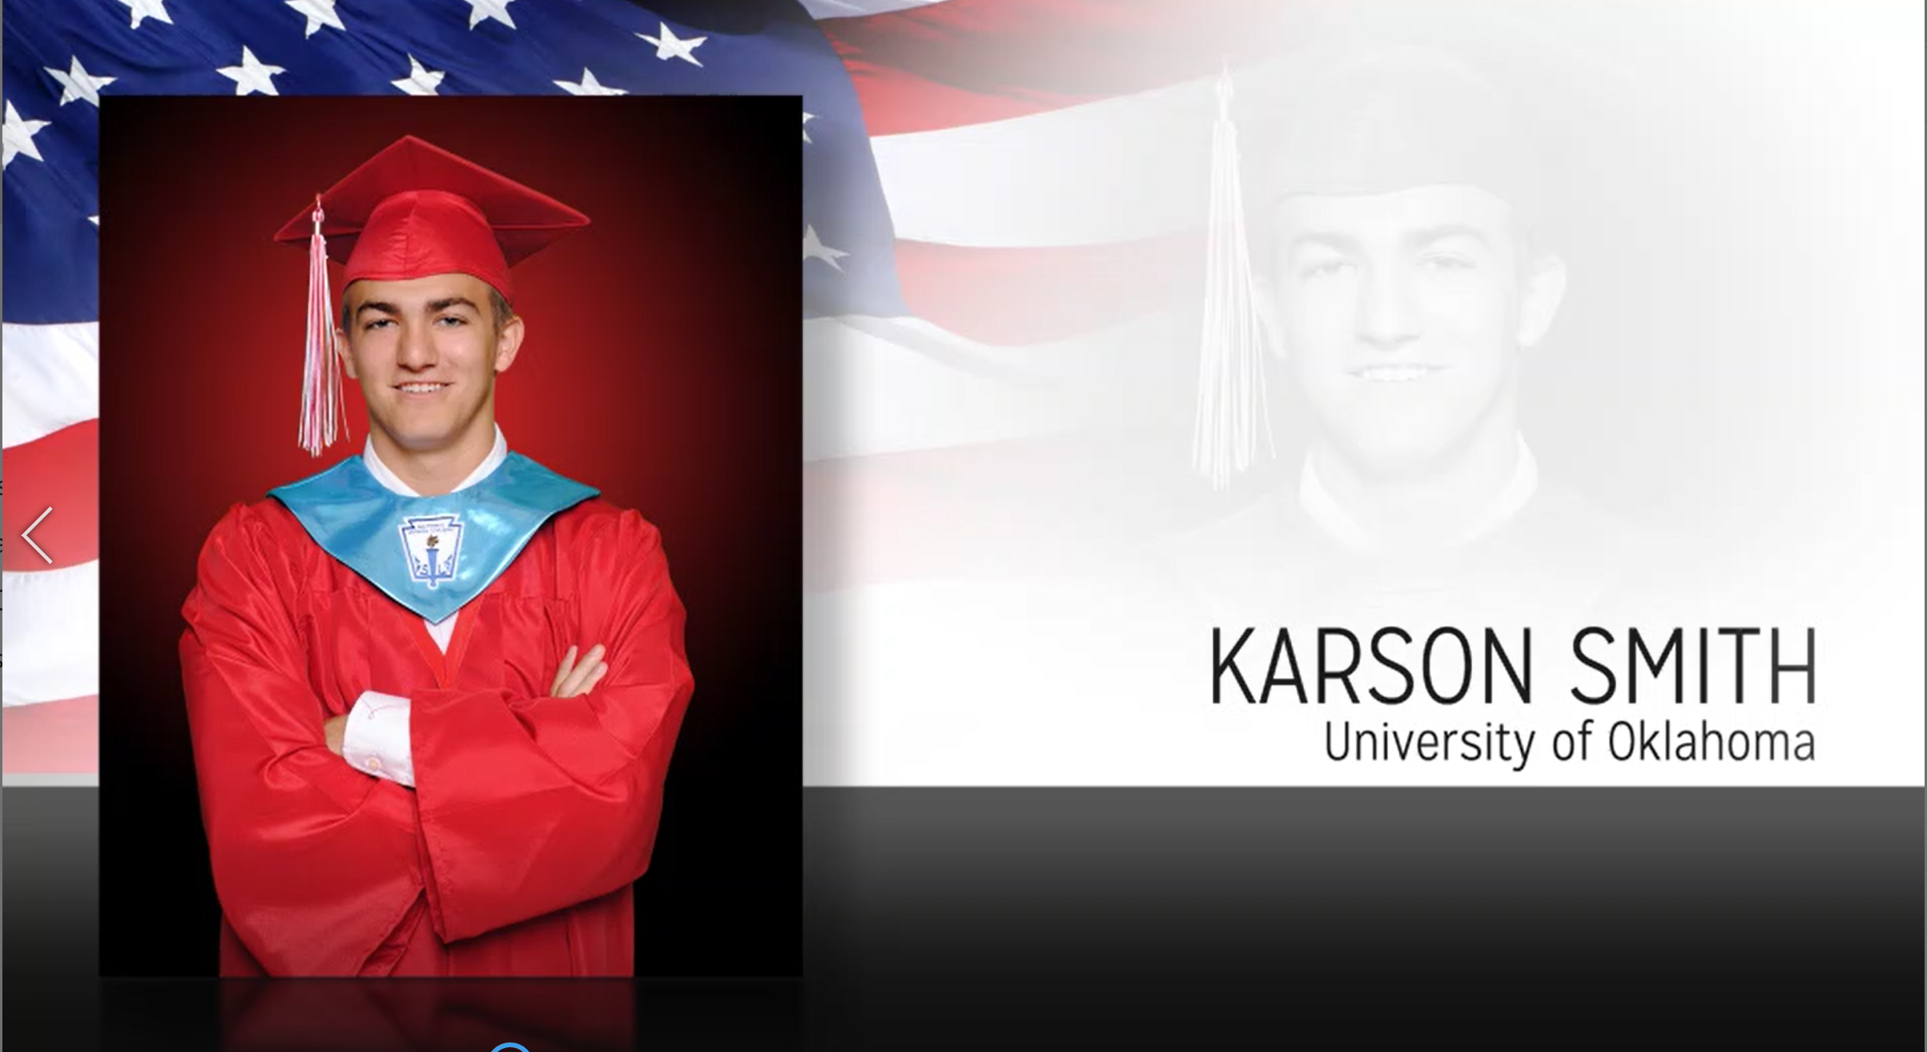
Ways to celebrate graduates
Graduate Animations
With and without music.
If added as a product on retail…. $6.
Bulk order for an entire school, class, college will be $4 each.
Pricing does not include image cutouts.
Delivery available to individuals like a typical download (mp4) OR we will offer bulk delivery to the photographer for bulk orders.

Slide 18
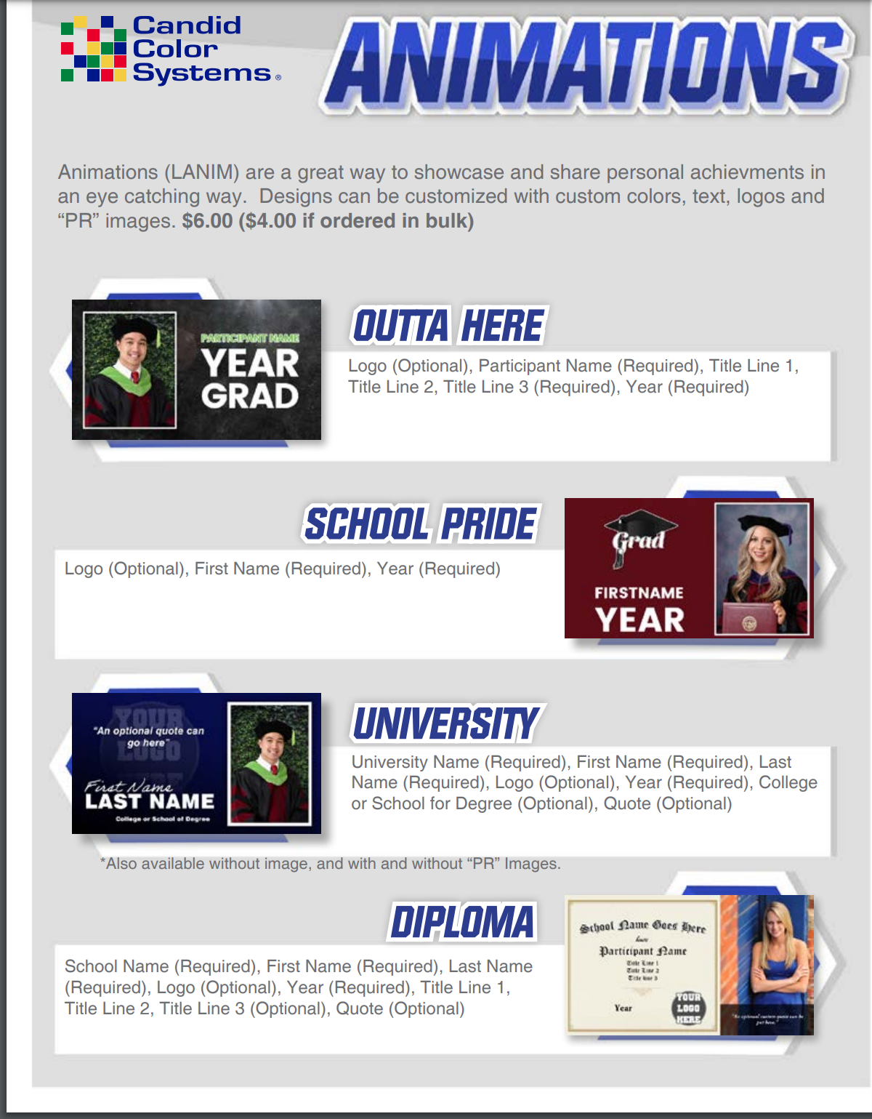
Ways to celebrate graduates
Graduate Animations Style Guide
A Version to show to schools and released samples available

Slide 19
Ways to celebrate graduates
Virtual Celebration registration
Do you need a way to collect information from students to decide who wants to participate in a Virtual Ceremony?
Or do you need a way to collect more student information so you can provide them with a Personal Achievement graphic or animation for social media? We can help!
We can provide a registration page to collect optional and required data that could include: Name, Degree, Major, student image, mailing address and more! We even offer an administration portal where you can review the information collected!
Use this option to collect data (and even images) to create some of these products and services.

Slide 20
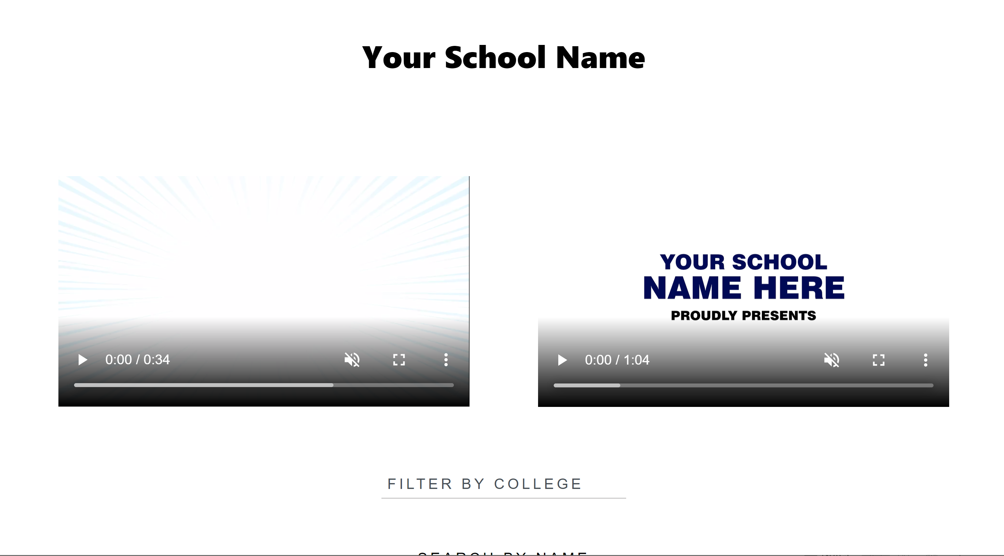
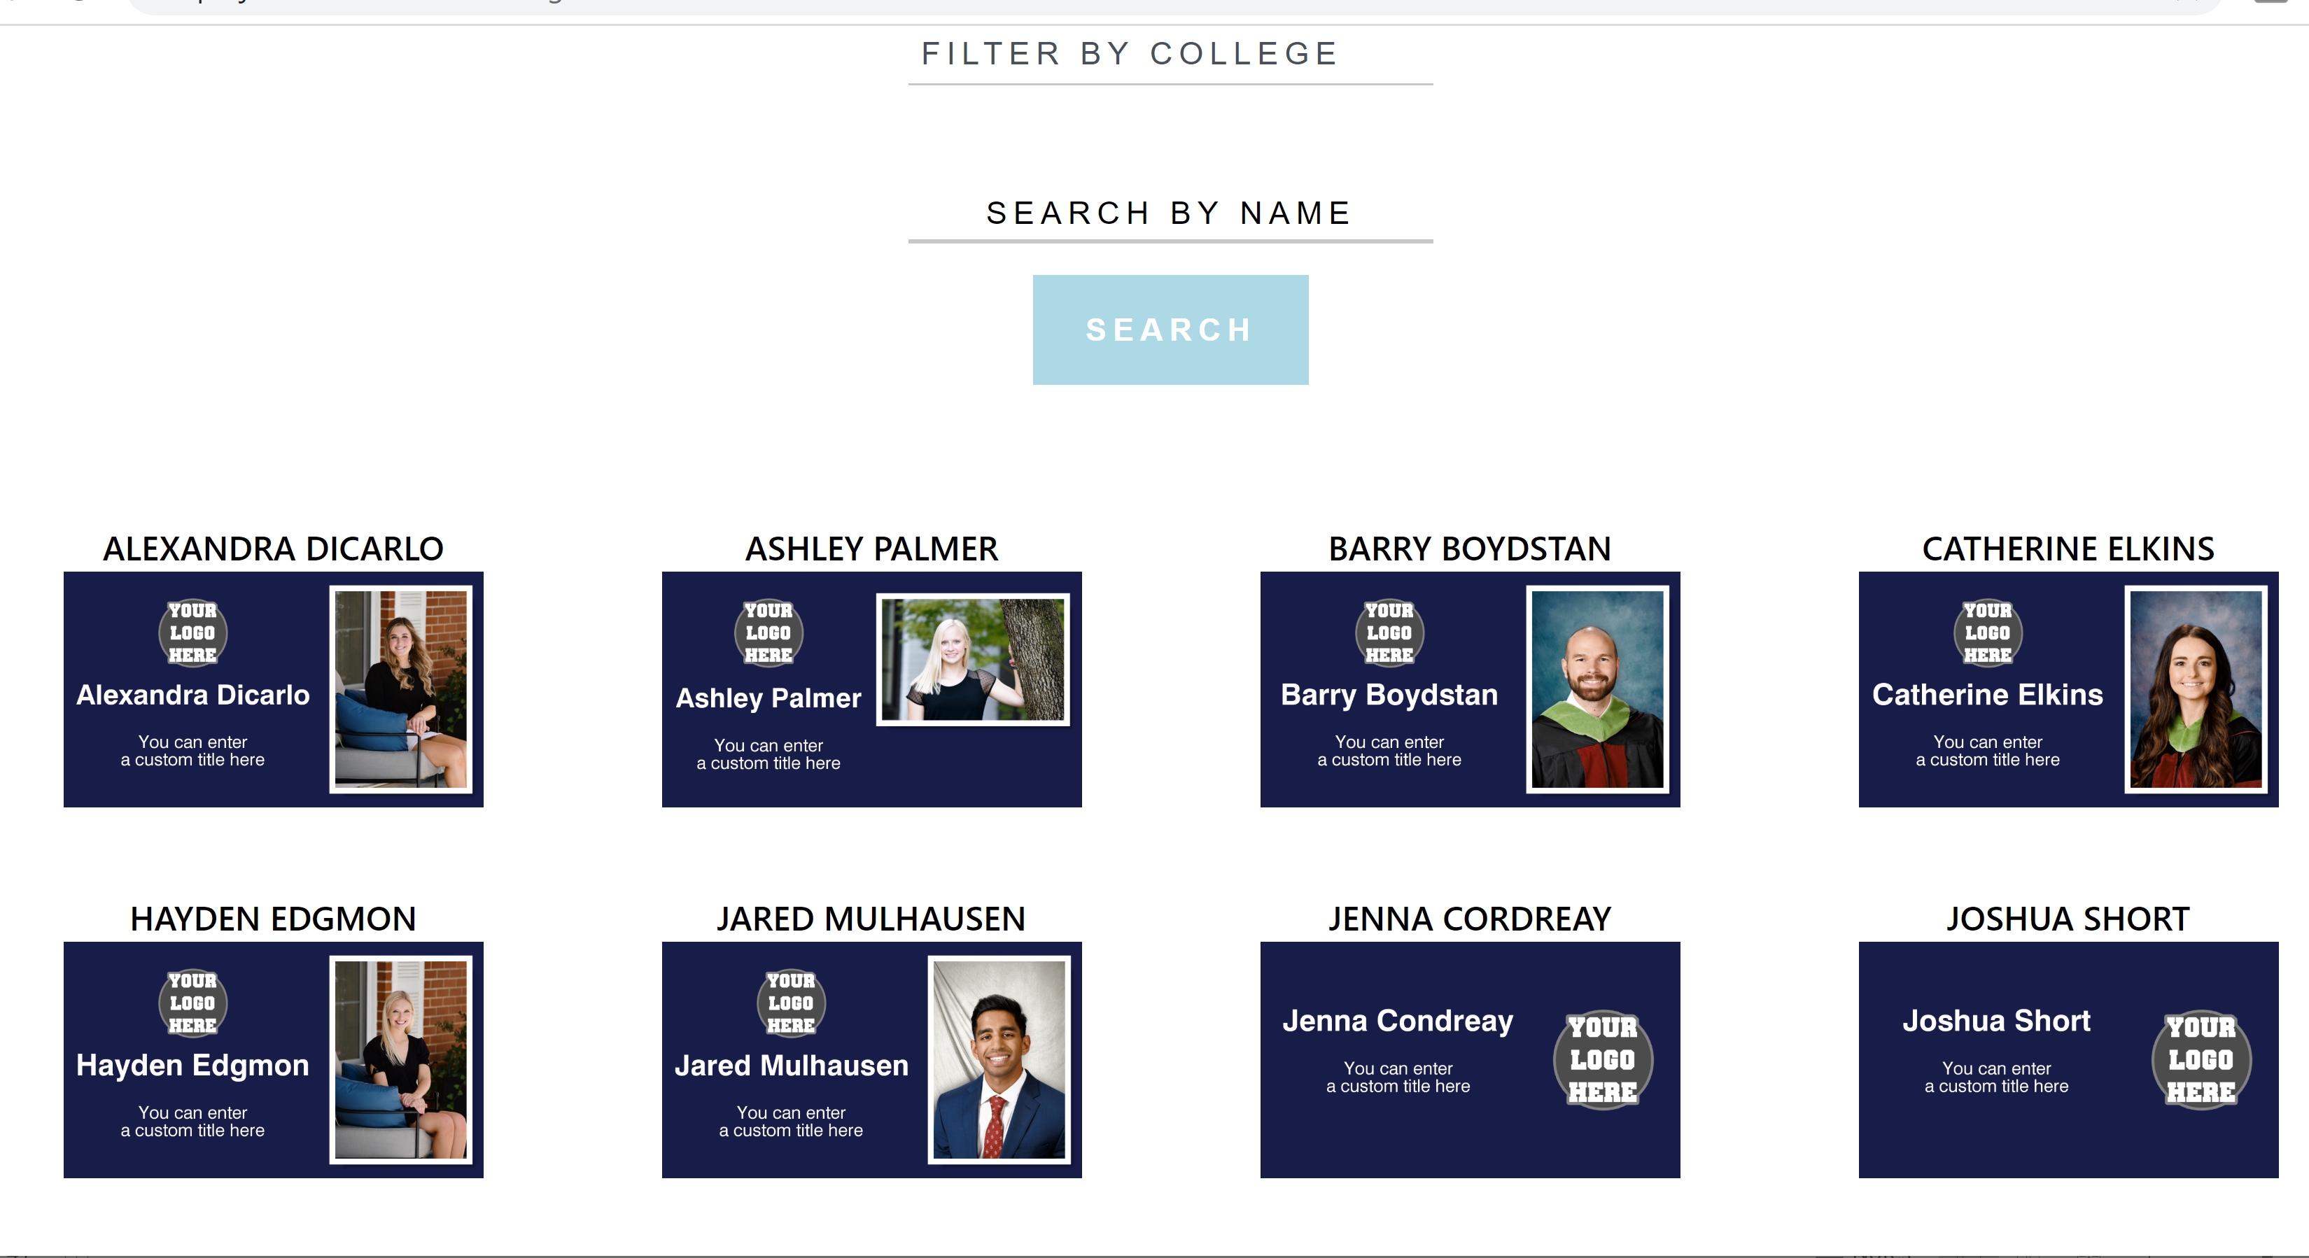
Ways to celebrate graduates
A Celebration page-
CCS will provide a custom page for each school (ordered/set up in CORE) where we will host the Virtual Ceremony video (slideshow of PAGs), the PAGs, NACs or animations if ordered and up to 3 videos provided by the school.
The cost is $100 and we will leave images for 5 years….maybe longer. That length is TBD

Slide 21
Grad Options
We had:
  Personal Achievement Graphics (PAG) $.59 each when ordered in bulk (JPGs)
  Animations $4 each (returned as MP4s)
  Virtual Ceremony videos $50 + $.15 per student (a video created from the personal achievement graphics….so this also required the $.59 per student PAG purchase) – with pomp and circumstance or no music
  A registration page tool (to collect student data and event images)- no cost

Slide 22
Grad Options
We have added:
  Name Announcement Clips (NAC) $1.18 – a super short movie file where we show the personal achievement graphic AND the student’s name is read aloud (great for social media)
  NOTE: When we make this product we ALSO make the PAG. So you do NOT need to Also buy the PAG. The student gets an NAC video and the PAG jpg
  Name reading option for the Virtual ceremony video. Additional $.15 per student. So the total video cost would be $50 + $.30 per student ($.15 + $.15)
  A Celebration page- CCS will provide a custom page for each school (ordered/set up in CORE) where we will host the Virtual Ceremony video (slideshow of PAGs), the PAGs, NACs or animations if ordered and up to 3 videos provided by the school. The cost is $100 and we will leave images for 5 years….maybe longer. That length is TBD

Slide 23
An Virtual Celebration
What would an entire virtual celebration package look like and what would it cost you?
Example: 300 student High School Includes:
  A Personal Achievement Graphic for each student
  A Virtual Ceremony
  A Graduate Animation for each student

Slide 24
An Virtual Celebration
What would an entire virtual celebration package look like and what would it cost you?
Example: 300 student High School Costs
  Personal Achievement Graphics - $177
  (ordered in bulk at $.59 each)
  A Virtual Ceremony - $95.15
  $50 + $45.15 ($.15 x 300)
  Graduate Animations- $1,200
  (Ordered in bulk at $4 each)
  TOTAL $1,477

Slide 25
An Virtual Celebration
How would you charge for this service?
(All pricing below assumes bulk orders for services/ no ecommerce fees)
  Social Media shout-out pack
    Personal Achievement Graphics for each student
    Your costs are- $.59/student
    You could charge- $3 per student
    You would make- $2.41/ student plus in office labor
  Social Media Celebration pack:
    Personal Achievement Graphics for each student
    Graduate Animations for each student
    Your costs are- $4.59/student
    You could charge- $7 per student
    You would make- $2.41/ student plus in office labor
  Registration site set up $150

Slide 26
An Virtual Celebration
How would you charge for this service? NEW
(All pricing below assumes bulk orders for services/ no ecommerce fees)
  Social Media recognition pack- NEW
    Personal Achievement Graphics for each student
    Name announcement clip (mp4) for each student
    Your costs are- $.1.18/student
    You could charge- $5 per student
    You would make- $3.82/ student plus in office labor
  Social Media DELUXE Celebration pack- NEW
    Personal Achievement Graphics for each student
    Name announcement clip (mp4) for each student
    Graduate Animations for each student
    Your costs are- $5.18/student
    You could charge- $12 per student
    You would make- $6.82/ student plus in office labor
  You could charge for Registration site set up- $150

Slide 27
An Virtual Celebration
How would you charge for this service?
(All pricing below assumes bulk orders for services/ no ecommerce fees)
  Ceremony pack:
    Personal Achievement Graphics for each student
    1 Virtual Ceremony video
    Your costs are- $50 + $.74 per student plus in office labor
    You could charge- $500 + $3.15 per student
    Additional Ceremony videos – you could give a discount on the flat rate
    You would make- $450 + $2.41/student
  Deluxe Ceremony pack:
    Personal Achievement Graphics
    1 Virtual Ceremony video
    Graduate Animations
    Your costs are- $50 + $4.74 per student plus in office labor
    You could charge- $500 + $7.15 per student
    Additional Ceremony videos – you could give a discount on the flat rate
    You would make- $450 + $2.41/student

Slide 28
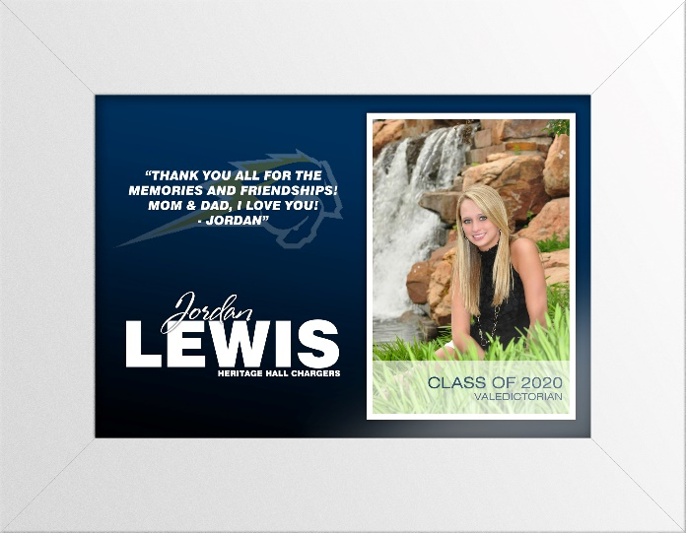
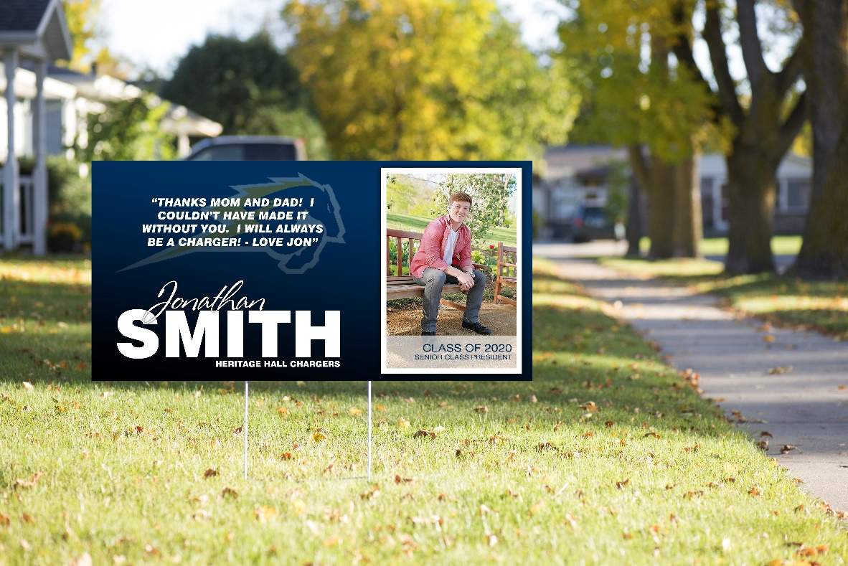
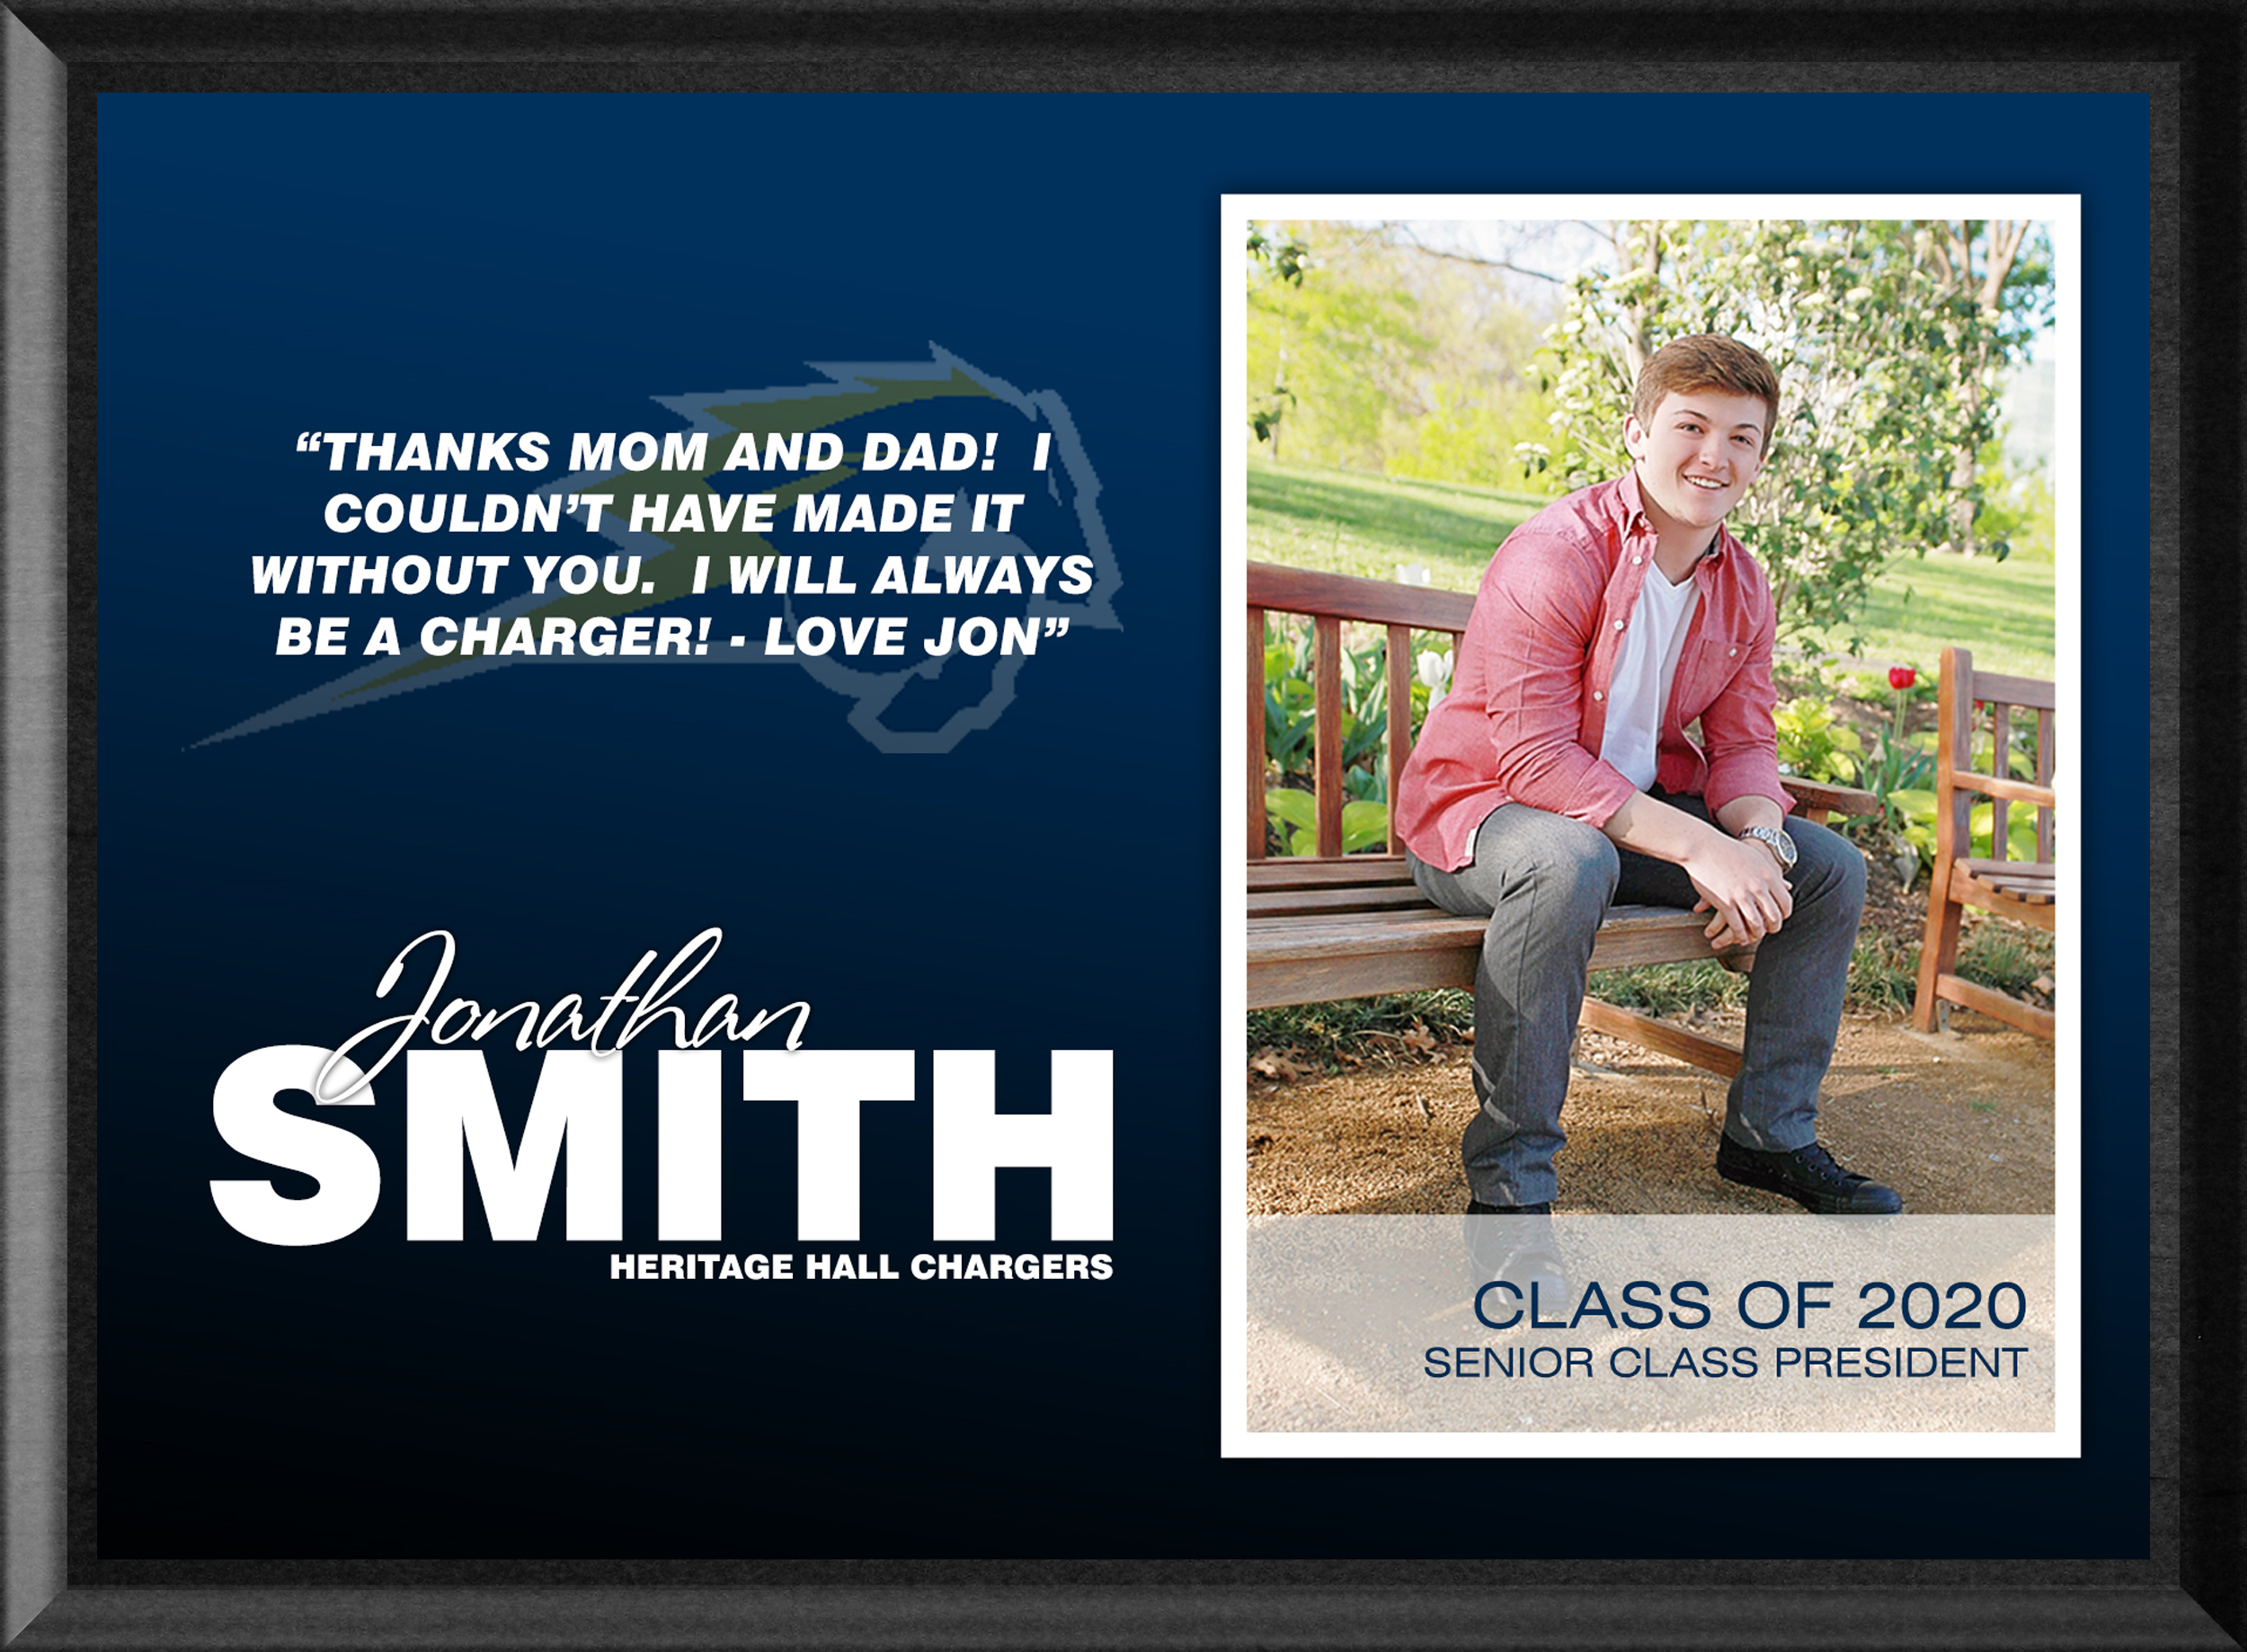
Ways to celebrate graduates
Personal Achievement Graphic (“PAGs”) products
Plaques, Prints, Framed prints, yard signs!

Slide 29
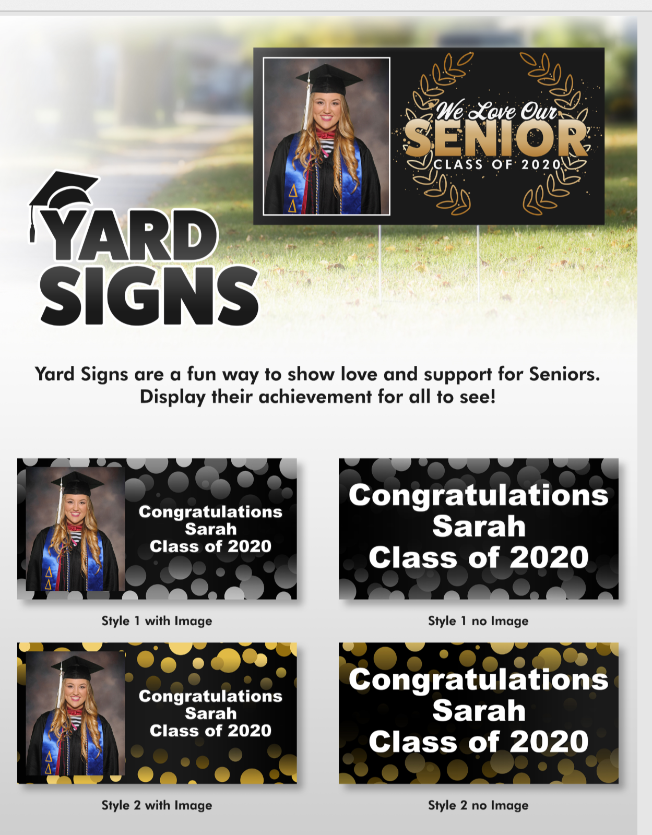
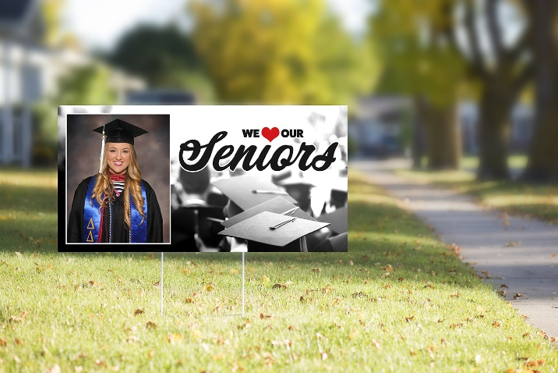

Ways to celebrate graduates
Yard Sign style guide and offer graphics available via the newsletter
A version with and without pricing (that you could show to schools)

Slide 30
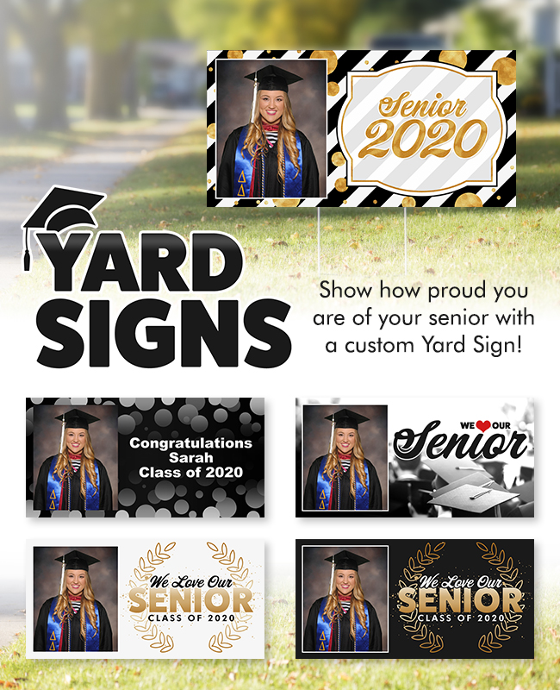

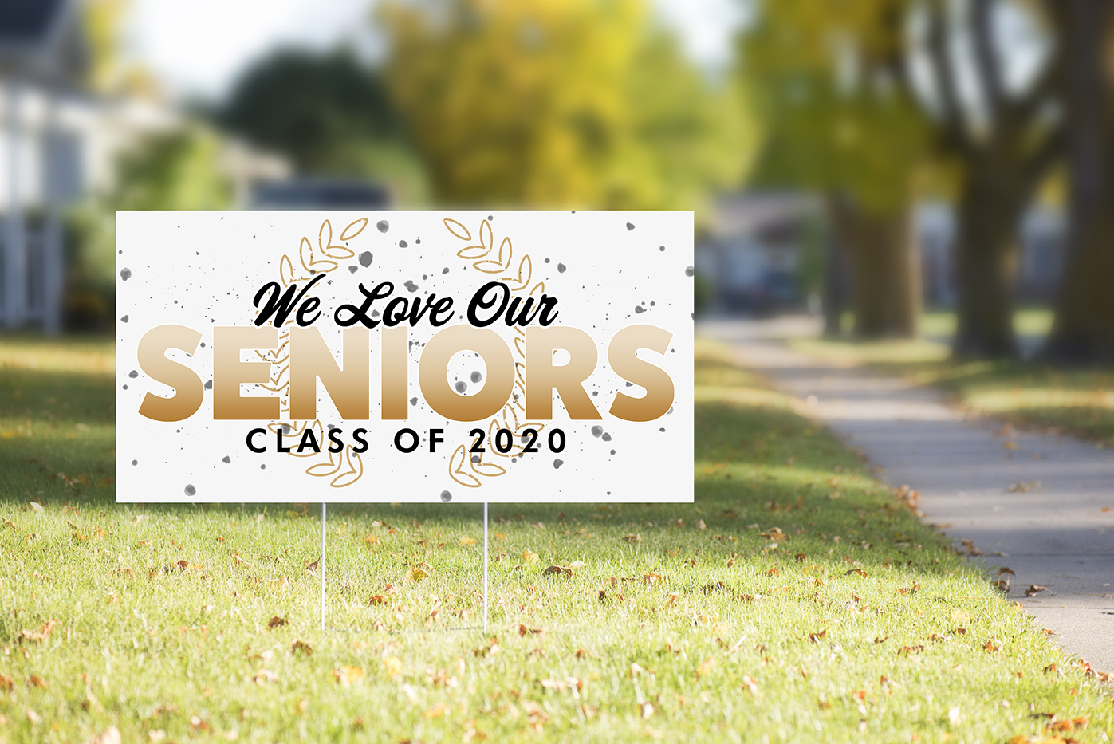
Ways to celebrate graduates
Yard Sign email and offer graphics available via the newsletter NOW

Slide 31
Ways to celebrate graduates
Graduation gifts
Are you trying to generate goodwill during time of uncertainty? Send your grads a gift! We can offer easy ways to send gifts to your graduates. We can even send these gifts to only graduates who register.
Consider customized mugs, plaques containing the student’s personal achievement graphics, spirit sticks that include the graduate’s cut-out, yard signs and much more!

Slide 32

Ways to celebrate graduates
Spirit stick email and offer graphics available via the newsletter

Slide 33

Tools you can use to sell these ideas
UPDATED Virtual Celebration Email and Flyer graphics
PSDs you can modify
Solutions on candid.com where you can link to samples
Logos
Power Point
Product flyers/ Style Guides
Released samples on developments

Slide 34
Start communicating with schools
Watch for our Virtual Celebration info
Get training on PhotoMatch, QR codes and Grad tag
See candid.com
What’s Next?

Slide 35
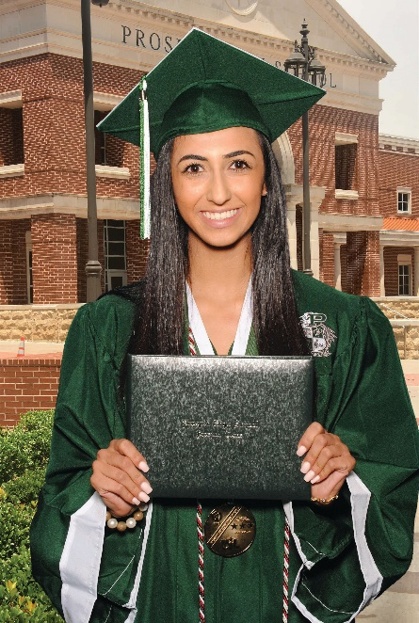
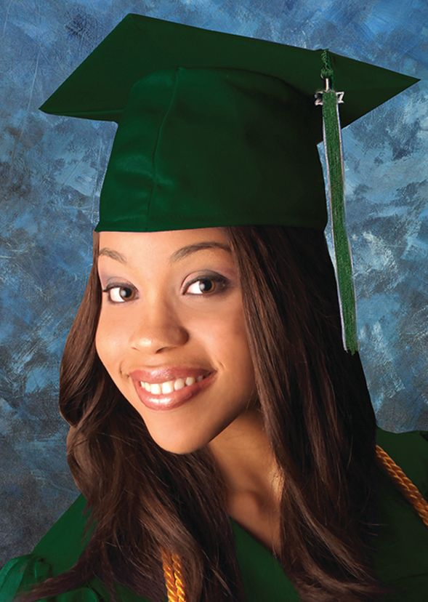

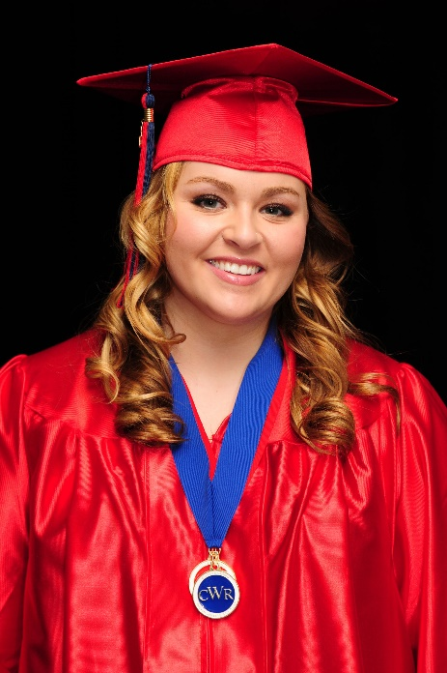
Thank yOu

Slide 36
Other solutions to think about

Slide 37
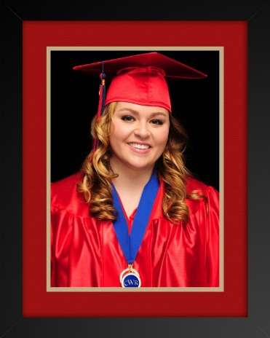
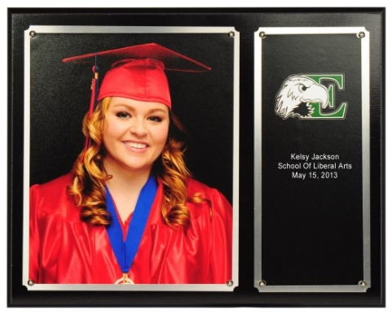
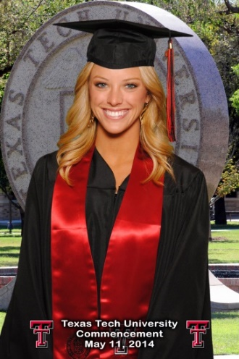
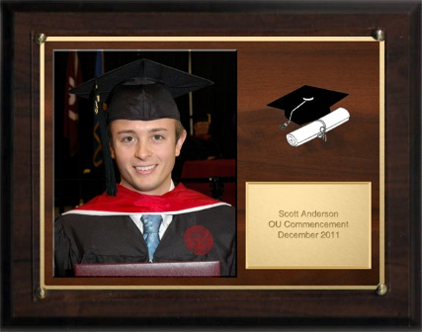
If you already have photos of the Graduates/ Seniors
The school could buy a commemorative item for each grad using those images (plaques, animations, etc)
Re-market using grad products

Slide 38
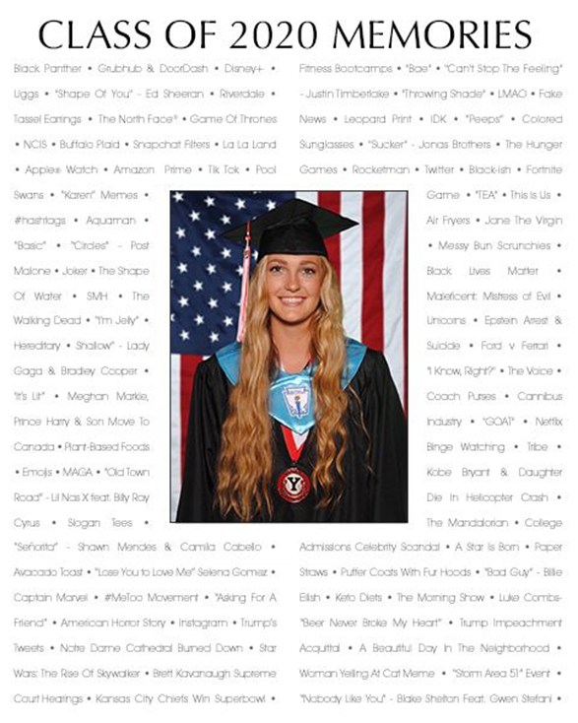

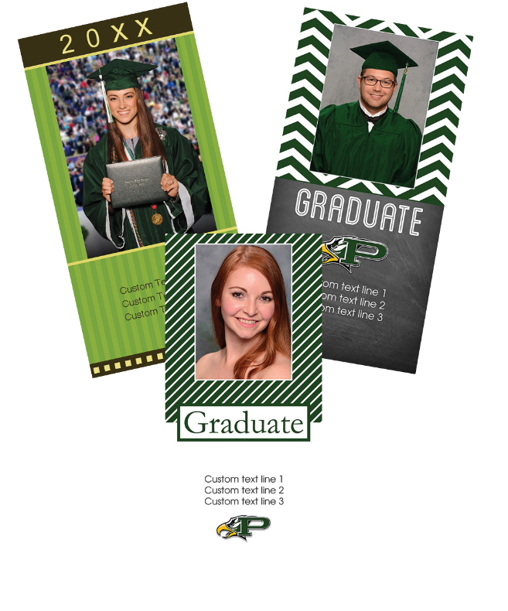
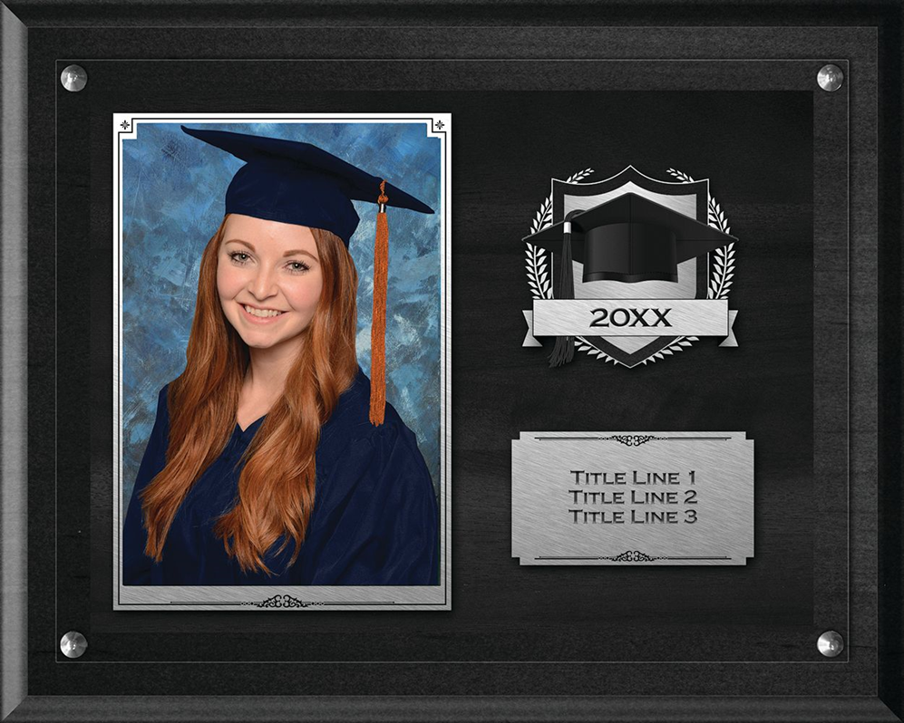
Let grads upload their own pics to get commemorative products
Some grads may have already picked up their cap & gown
Encourage grads to dress in regalia for their photo(s)
The school could buy a commemorative item for each grad using those images (plaques, animations, etc)

Slide 39


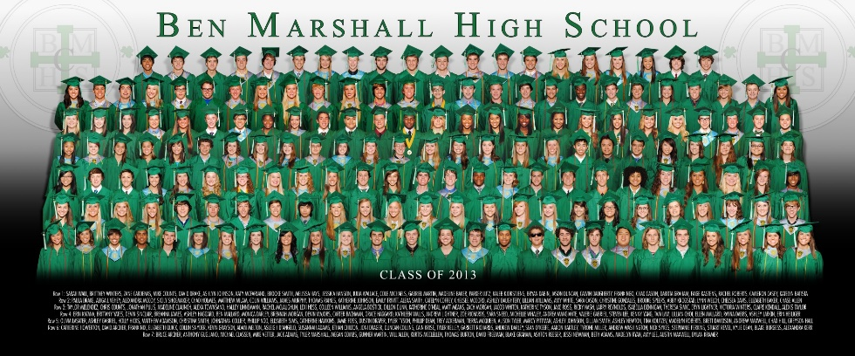
Products you can use NOW
Virtual Groups

Slide 40

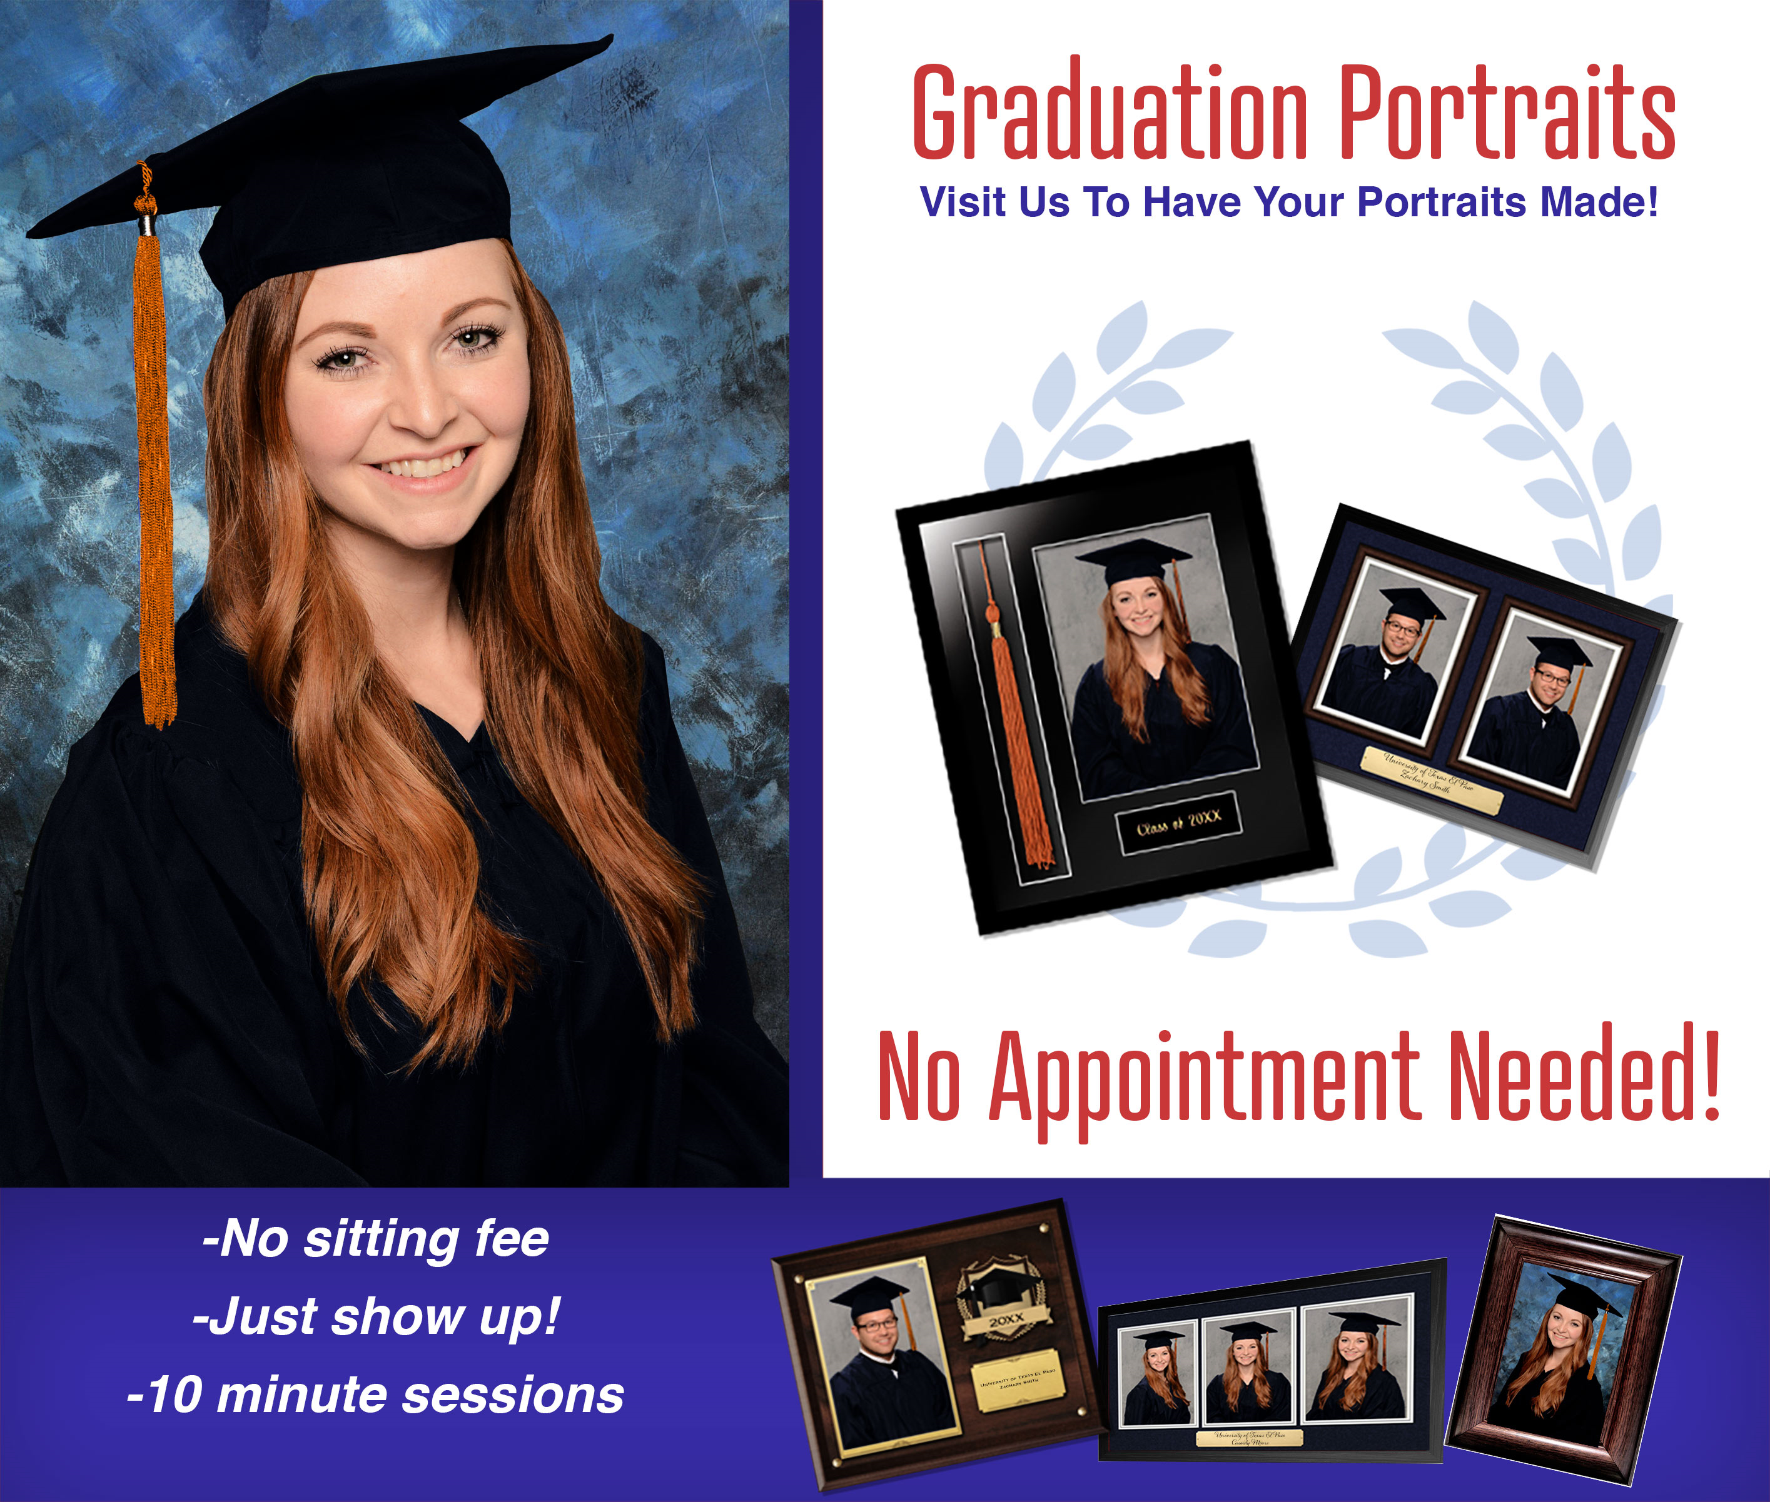
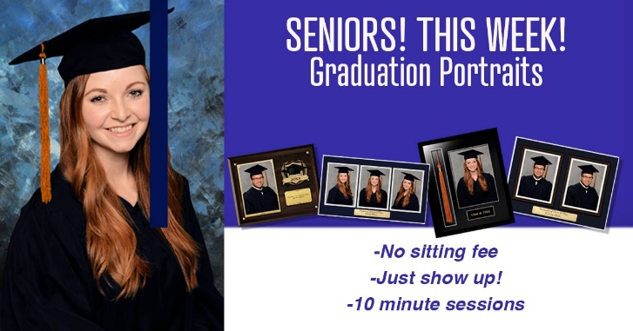
Portrait sessions
Use youcanbook.me or something similar to take appointments and (possibly) accept session fees

Slide 41



Marketing emails available

Slide 42


Marketing

Slide 43

