Slide 1


Your Photography Company Name

Slide 2
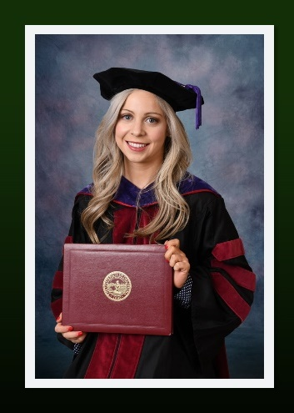
A New Tradition for the Times
There are solutions to recognize your graduates even with the limits of social distancing
We have the tools to help you still make this a memorable graduation

Slide 3

Drive by Diploma Presentation
Have graduates stop by school at staggered times
Pick up diploma cover
Have portrait taken with studio lighting
  Will be used for the Celebration Video and graphics
All can be done from the parking lot of the school with social distancing
Graduates would wear cap & gowns if already available
  They would dress up for photos if not

Slide 4
Your Virtual Celebration
We will use the professionally captured images to create:
  Personal achievement graphics for each student (JPGs that each student can share on social media)
  A Virtual Ceremony Slideshow video containing the personal achievement graphics for each student (an mp4 video file)
  A Celebration Webpage for your school

Slide 5


Personal Achievement Graphic
Choice of 2 Styles & colors
Used to create the Celebration Video
Can be individually searched, downloaded & shared on social media from the Celebration webpage
Each graphic can contain:
  Photo (optional)
  Name
  Distinction (optional)
  School Name
  School Logo
  Quote (optional)

Slide 6
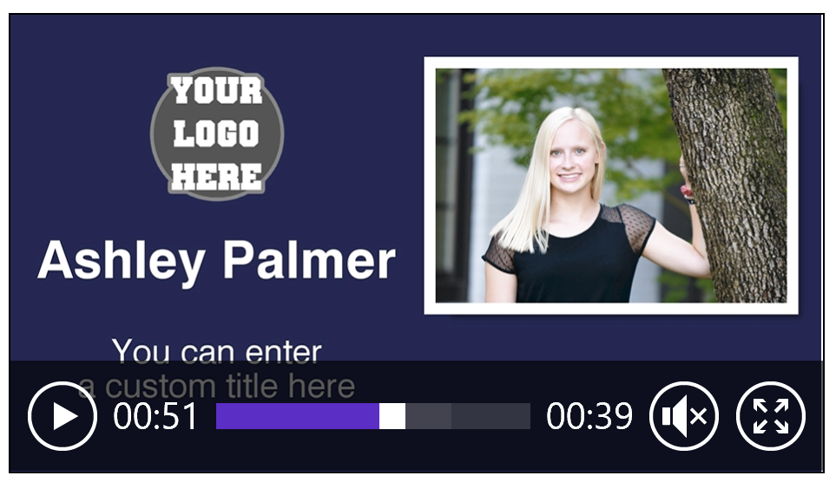
Virtual Ceremony slideshow video
Includes a slide for each graduate
Pomp and Circumstance plays in the background
Or receive the video with no audio
Link to sample Video
https://tinyurl.com/y8d8eqqu

Slide 7
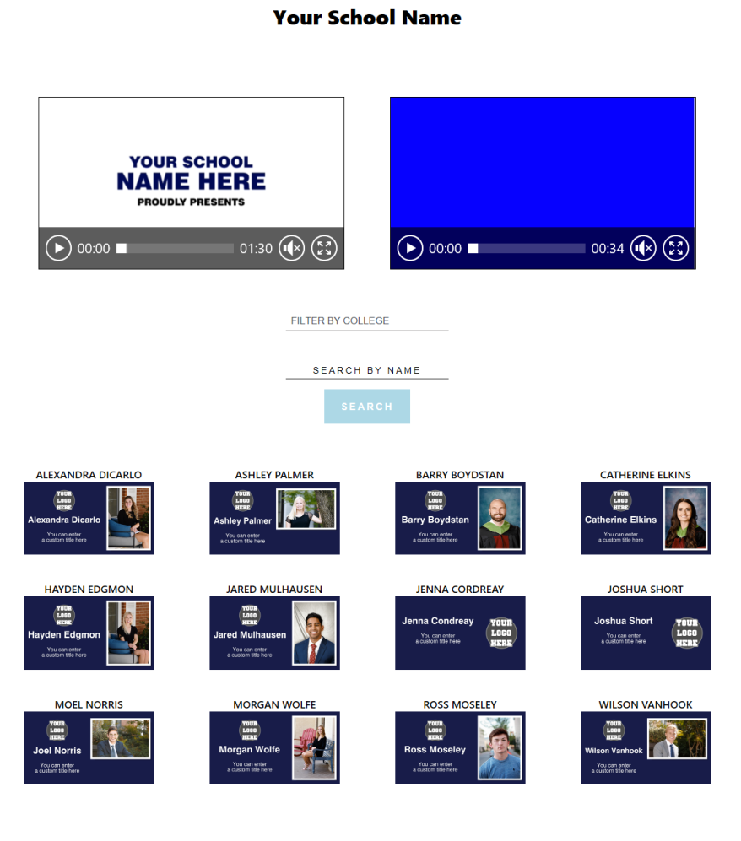
Virtual Celebration Webpage
School branding
Up to 10 Videos from the school.
  Examples:
    Senior Recognition Video
    Speeches
Personal achievement graphics for each student (searchable)

Slide 8
Include up to 3 Speech Videos for the Celebration webpage
Record each speech
Can be recorded on phone
Upload to YouTube and provide a link
We will insert each into Celebration Page
A senior slideshow can be utilized in place of one of the speeches
Principal’s Message
Valedictorian Speech
Salutatorian Speech

Slide 9

Virtual Group Class Photo
Created from Individual Portraits
Each graduate is identified in the group photo
Available for purchase online
School receives 2 framed copies for display

Slide 10
Virtual Ceremony Prices
NOTE: there are 3 versions in this presentation. Select before talking to your school and delete the others.

Slide 11
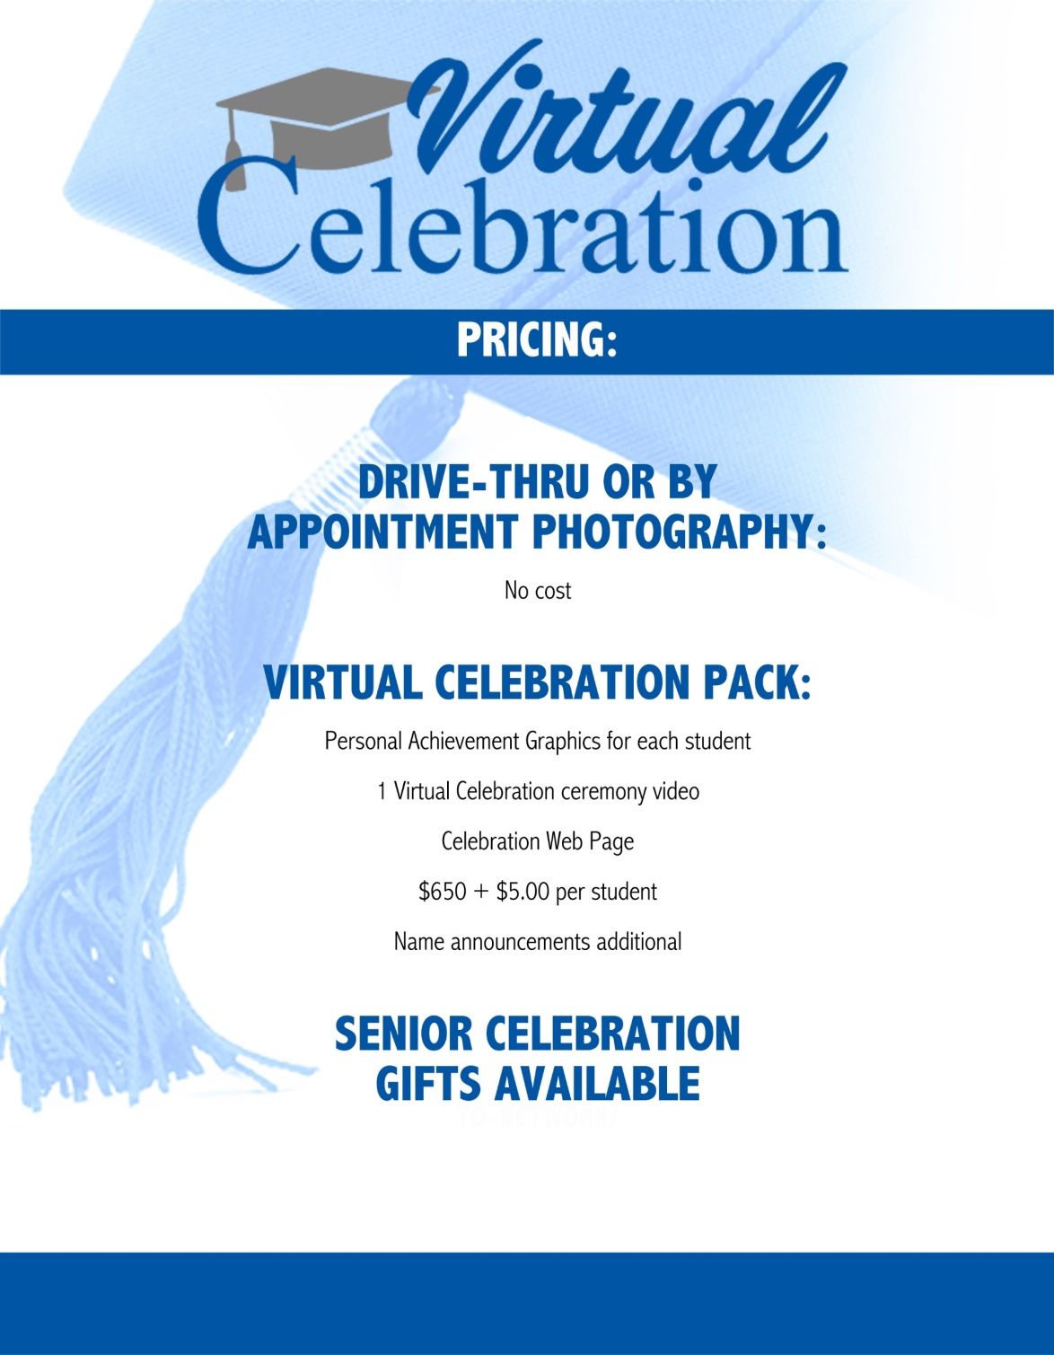
Pricing to use if you are able to capture professional pics and Add on the virtual ceremony

Slide 12

Pricing that could be used if you want a minimum fee for the work – the min covers up to 300 students

Slide 13
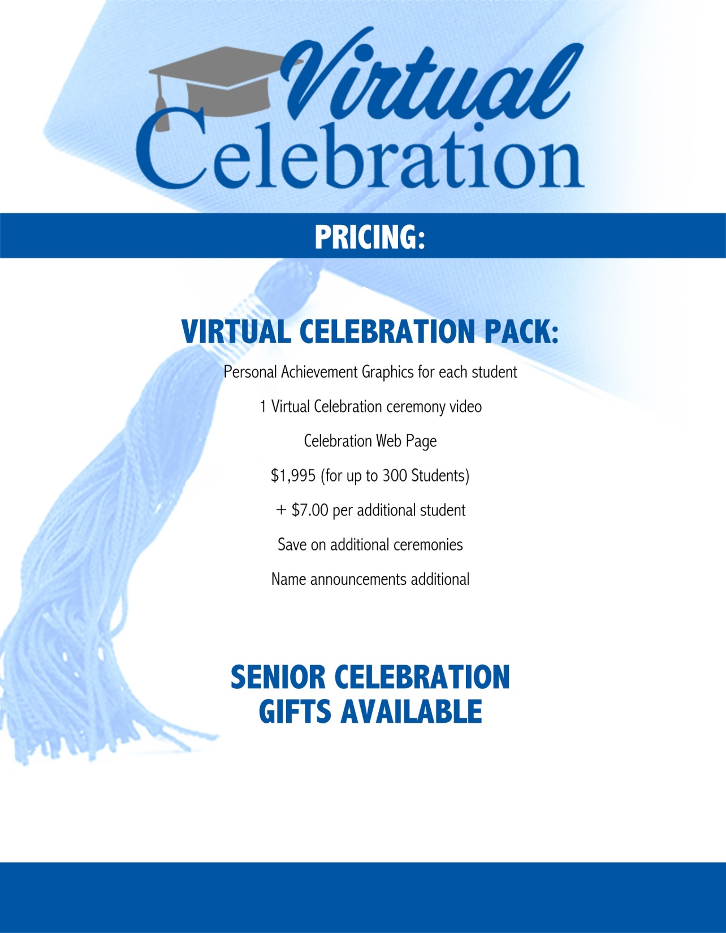
Pricing for a college or where you are NOT able to have a Drive thru or professional opportunity

Slide 14
What Your School Provides
The photography opportunity during diploma pick-up
Up to 3 Videos for the Celebration Web Page
  These can be as fancy or as simple as you would like
  You can even do these on your phone or tablet
  Upload to YouTube and send us a link
High Res School Logo
Choice of Personal Achievement Graphic (select a Style)

Slide 15

What We Provide
Touchless/ Safe Portraits
Unique Celebration Page/website for you to share
Individual Personal Achievement Graphics
Celebration Video recognizing each graduate

Slide 16
Contact us to begin planning your Virtual Celebration

