Slide 1
Your Photography Company Name

Slide 2
A New Tradition for the Times
There are solutions to recognize your graduates even with the limits of social distancing
We have the tools to help you still make this a memorable graduation

Slide 3
Graduate Registration for Virtual Celebration
Links to a school dedicated registration page are emailed to each graduate
A roster of graduates with emails will allow us to make each registration page unique to that graduate
Each graduate verifies the spelling of their name for use when recognized in the video
Each graduate will also upload an image to be used preferable in Cap & Gown

Slide 4
Your Virtual Celebration
We will use the graduate’s uploaded images from the registration site to create:
Personal achievement graphics for each student (JPGs that each student can share on social media)
A Virtual Ceremony Slideshow video containing the personal achievement graphics for each student (an mp4 video file)
A Celebration Webpage for your school

Slide 5
Personal Achievement Graphic
Choice of 2 Styles & colors
Used to create the Celebration Video
Can be individually searched, downloaded & shared on social media from the Celebration webpage
Each graphic can contain:
Photo (optional)
Name
Distinction (optional)
School Name
School Logo
Quote (optional)

Slide 6
Virtual Ceremony slideshow video
Includes a slide for each graduate
Pomp and Circumstance plays in the background
Or receive the video with no audio
Link to sample Video
https://tinyurl.com/y8d8eqqu

Slide 7
Virtual Celebration Webpage
School branding
Up to 10 Videos from the school.
Examples:
Senior Recognition Video
Speeches
Personal achievement graphics for each student (searchable)

Slide 8
Include up to 3 Speech Videos for the Celebration webpage
Record each speech
Can be recorded on phone
Upload to YouTube and provide a link
We will insert each into Celebration Page
A senior slideshow can be utilized in place of one of the speeches
Principal’s Message
Valedictorian Speech
Salutatorian Speech

Slide 9
Virtual Ceremony Prices NOTE: there are 3 versions in this presentation. Select before talking to your school and delete the others.

Slide 10
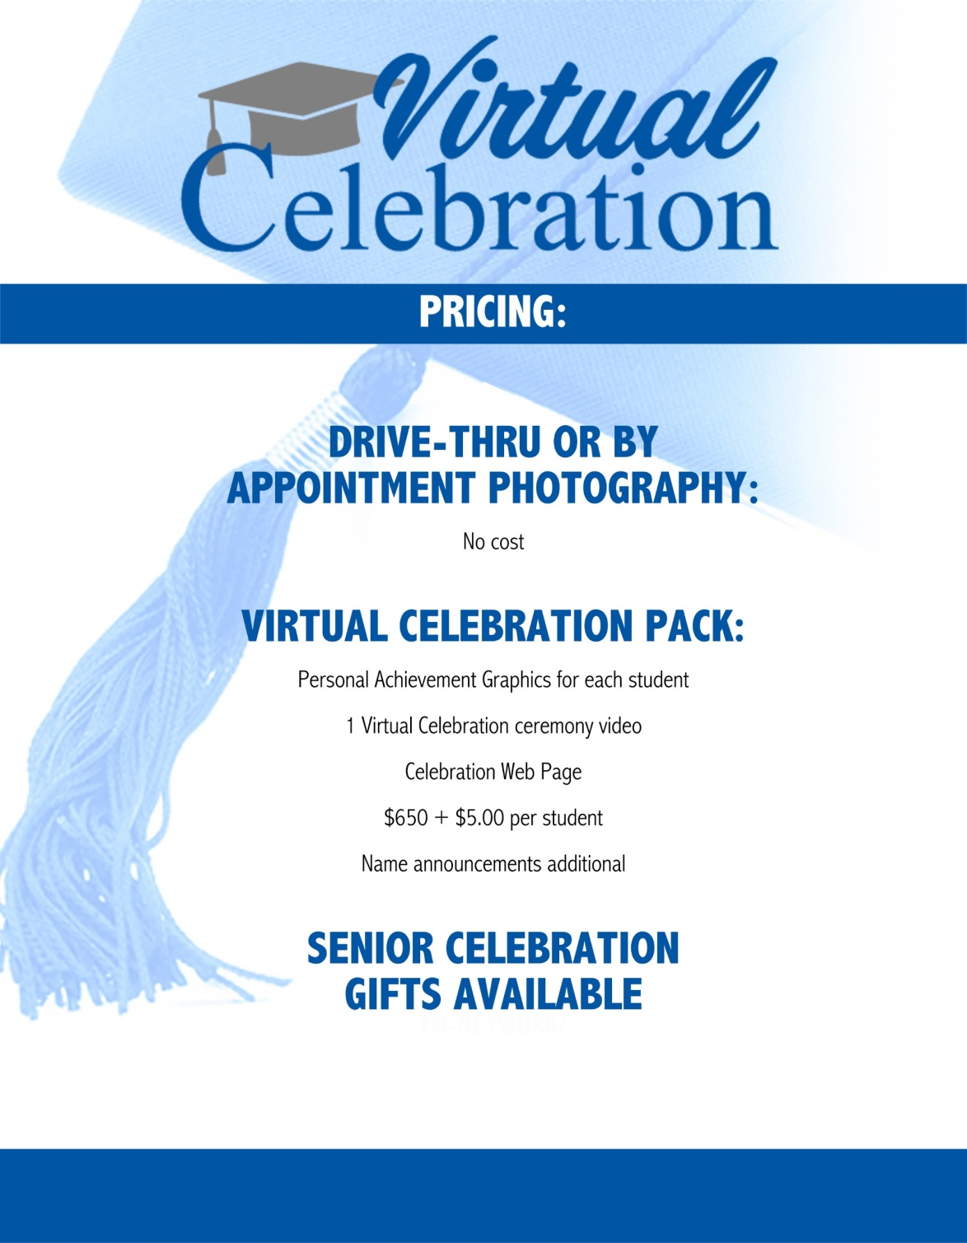
Pricing to use if you are able to capture professional pics and Add on the virtual ceremony

Slide 11
Pricing that could be used if you want a minimum fee for the work – the min covers up to 300 students

Slide 12
Pricing for a college or where you are NOT able to have a Drive thru or professional opportunity

Slide 13
What Your School Provides
Roster of graduates with emails for us to send out the unique registration links
Graduate will verify name and upload personal photo
Up to 3 Videos for the Celebration Web Page
These can be as fancy or as simple as you would like
You can even do these on your phone or tablet
Upload to YouTube and send us a link
High Res School Logo
Choice of Personal Achievement Graphic (select a Style)

Slide 14
What We Provide
Unique Celebration Page/website for you to share
Individual Personal Achievement Graphics
Celebration Video recognizing each graduate

Slide 15
Contact us to begin planning your Virtual Celebration

