Slide 1
New Safer, Social Distancing Procedures for Picture Day
YOUR LOGO HERE

Slide 2
We Miss Our Schools, The Students & Their Families!

Slide 3
We Will Be Ready to Come Back When You Are!
In addition to our regular safe environment (cleaning equipment, privacy of photos, etc.) we will be adding extra safety measures going forward to ensure an EVEN SAFER experience for everyone involved. We can’t wait to get back to doing what we love – capturing your child’s school and class portraits!

Slide 4
Making Time for Safety
We are scheduling more time between classes to limit the number of people in the photography area/hallways.
Likewise, we ask that only students/staff getting photos taken be allowed in the photography area.
We can schedule more Picture Days to accommodate proper distancing.

Slide 5
Digital Artwork
We offer “Virtual Group” or “Composite” class and/or staff photos.
These photos are created using individual images.

Slide 6
Sanitize & Sanitize Some More
Where there are any props involved, we will have hand sanitizer for the student to use before and after photography.
All props will be sanitized between each student.

Slide 7
Touch-Free Policy
We will provide NO TOUCH services wherever possible for Picture Day by eliminating the use of forms, allowing online ordering, and sending orders direct to parent’s home.

Slide 8
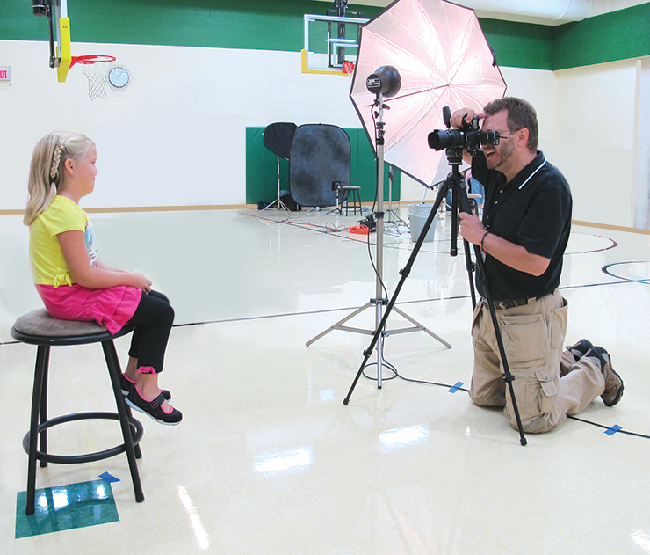
The Wellbeing of our Staff
Our employees that are within 6 feet of a child will be required to wear a face covering.
We will constantly monitor the health of our employees.

Slide 9
We Can’t Wait to See You! Please let us know if there are any special needs your school may have! We look forward to our new normal together!

